Slide 1

Analyzing Booking Trends in the Hospitality Industry
A predictive model to determine the booking status of a customer
Benita E. Irukwu

Slide 2
Business Introduction
Hotel Haven is a luxury hotel chain with multiple locations.
Offers various room types, meal plans, and parking options.
Faces challenges in predicting customer cancellations, which impacts their ability to manage resources effectively.
Goal: Understand booking patterns and create strategies to improve customer retention and reduce cancellations.

Slide 3

Table of Contents
Business Introduction
Problem Statement
Aim of the Project
Research Questions
Rationale for the Project
Summary
Data Description
Deliverables
Feature Importance Analysis
Overall Strategic Insight
Conclusion
Reccommendation
Final Remark

Slide 4
Problem Statement
High cancellation rates lead to lost revenue and inefficient resource allocation.
Existing system lacks insights into why customers cancel their bookings.
Management seeks to predict cancellations based on booking data to improve operational efficiency and customer retention.

Slide 5
Aim of the Project
Develop a predictive model to determine the booking status of hotel customers
Analyze booking data to identify patterns and factors influencing cancellations
Support management in making data-driven decisions to improve customer retention and resource allocation
Enhance operational efficiency and guest satisfaction by reducing cancellation rates

Slide 6
Research Questions
What are the key factors that influence booking cancellations in the hospitality industry?
How accurately can booking status be predicted using available customer and booking data?
Which data features contribute most to customer retention and reduced cancellations?
How can predictive insights be used to optimize hotel resource management?

Slide 7
Rationale for the Project
Understanding Cancellation: Analyze booking patterns to uncover reasons for cancellations.
1
Identifying Key Factors: By examining variables like lead time, room type, market segment, and price, specific factors that influence customers' decisions to either cancel or keep their bookings are identified.
2
Optimizing Satisfaction: By minimizing cancellations, the hotel can ensure better resource allocation and improved guest experience.
3

Slide 8

Summary
The presentation outlines a data-driven approach to help Hotel Haven predict booking cancellations, understand customer behavior, and optimize hotel operations. The project involves cleaning and analyzing booking data, developing predictive models, and delivering actionable insights to improve customer retention and resource management.

Slide 9
Data Description (Part 1)
Booking ID: Unique identifier for each booking (String)
Number of adults and children (Integer)
Number of weekend and week nights (Integer)
Meal plan selection (Categorical)
Car parking space (Binary)
Room type (Categorical)
Lead time (Integer)
Market segment type (Categorical)

Slide 10
Data Description (Part 2)
Repeat customer status (Binary)
Customer profile indicators (Binary)
Average price (Float)
Special requests (Integer)
Date of reservation (Date)
Booking status (Categorical)

Slide 11
Deliverables
Data Cleaning
Data Exploration
Comprehensive Data Analysis
Feature Engineering and Model Development
Model Evaluation and Fine-Tuning
Jupyter Notebook and PowerPoint Slides

Slide 12
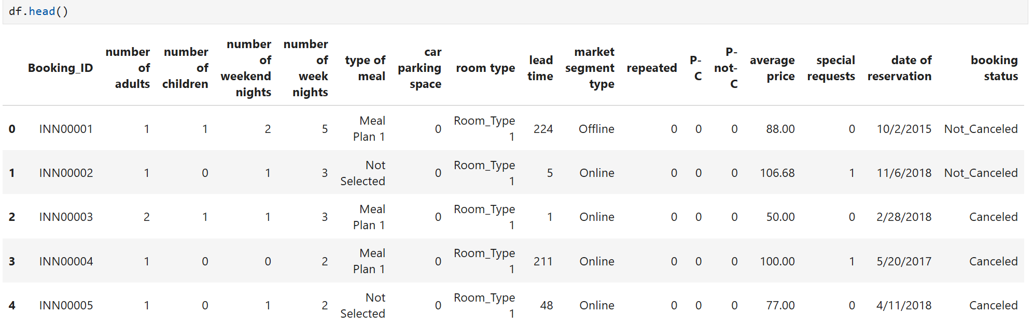
Data Info

Slide 13
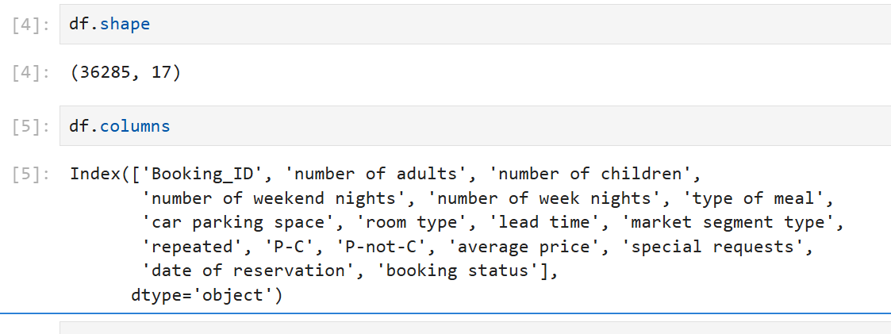
Notes:
To confirm the data dictionary

Slide 14
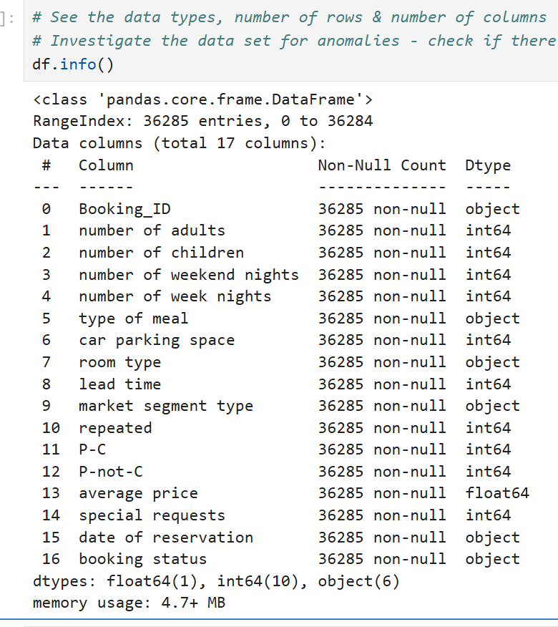
Investigating The Data Set

Slide 15
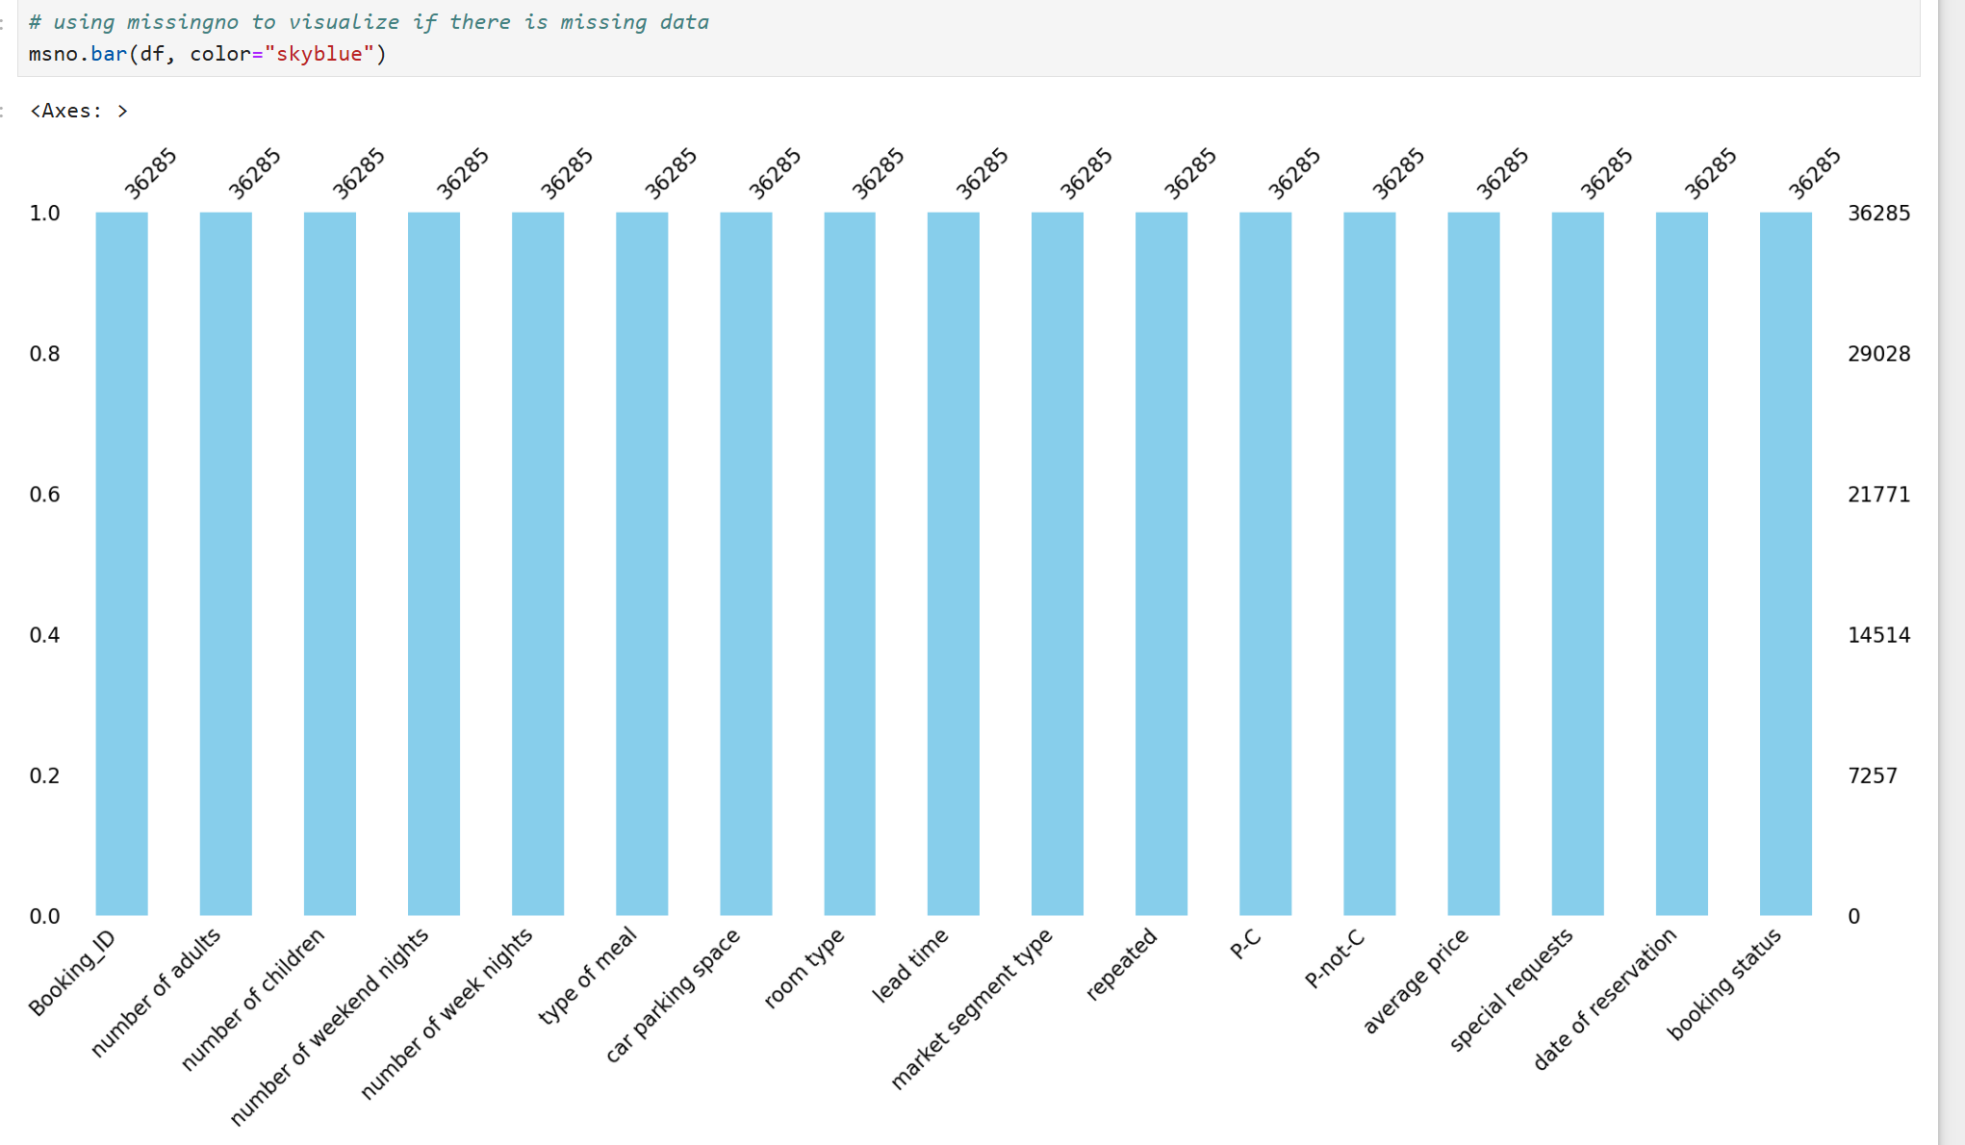

Slide 16
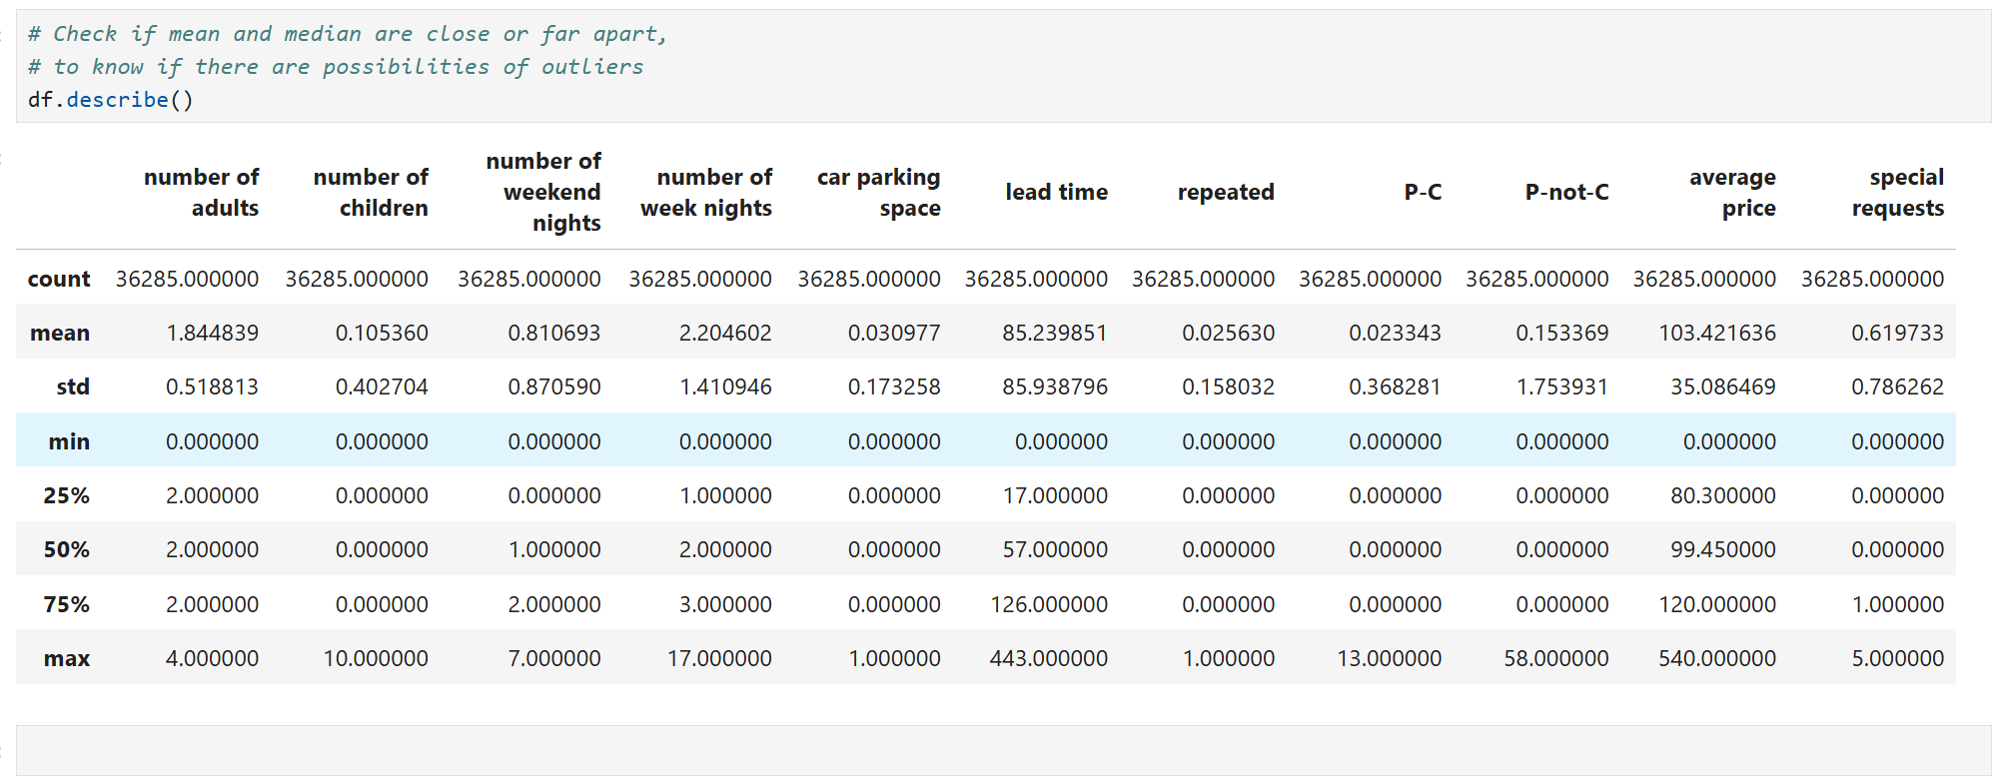
Numerical Statistical Analysis

Slide 17
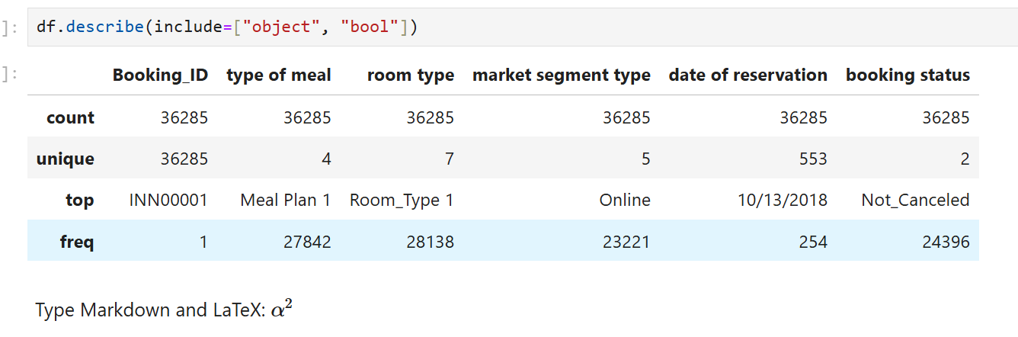
Categorical Statistical Analysis

Slide 18
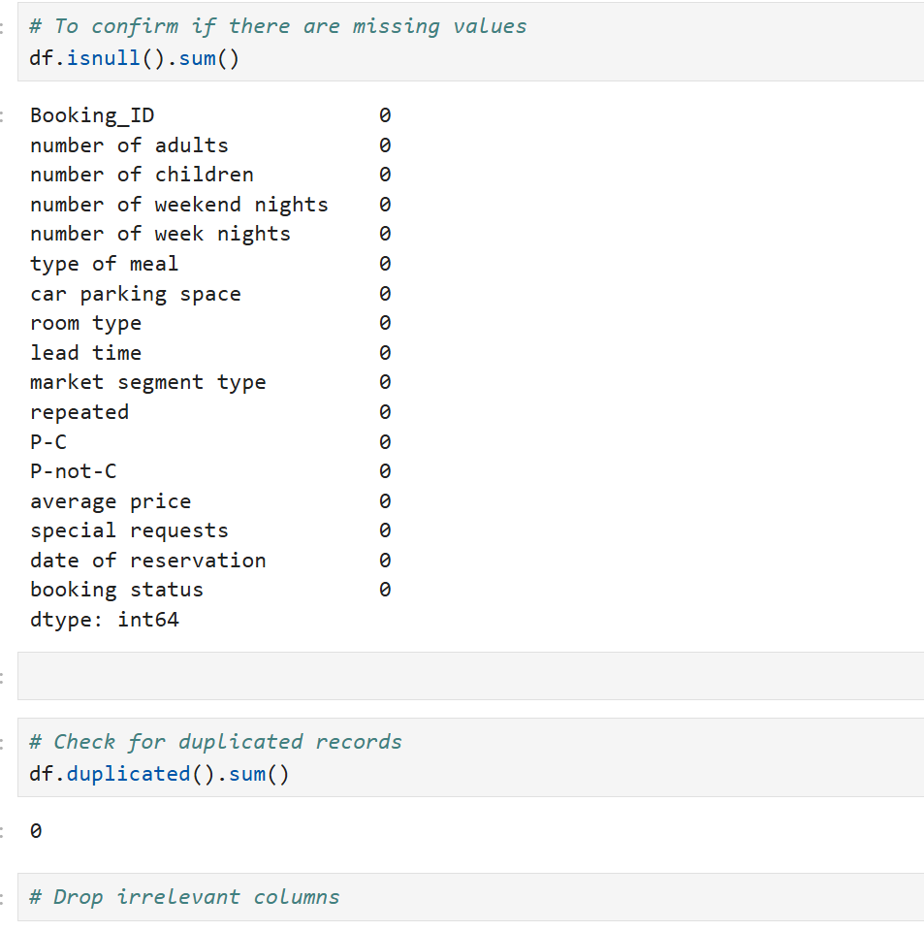
Data Cleaning

Slide 19

Exploratory Data Analysis

Slide 20
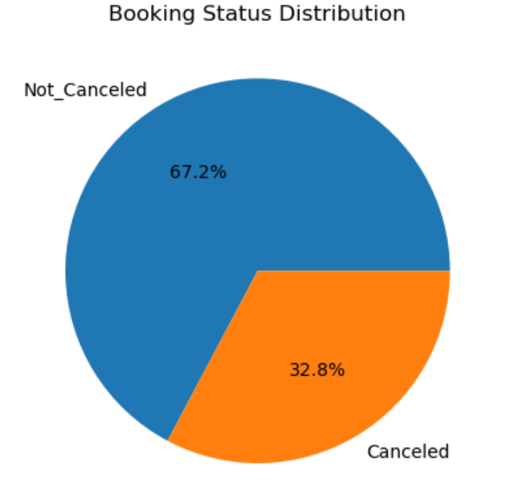
Key Observation
Percentage of cancelled bookings is significantly high - 33%.
Its high enough to affect revenue

Slide 21
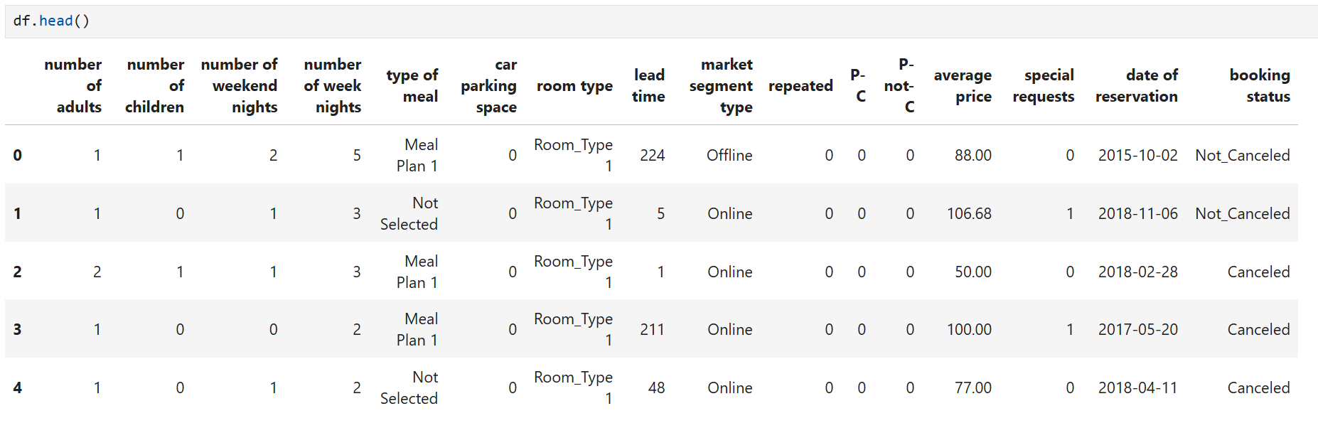
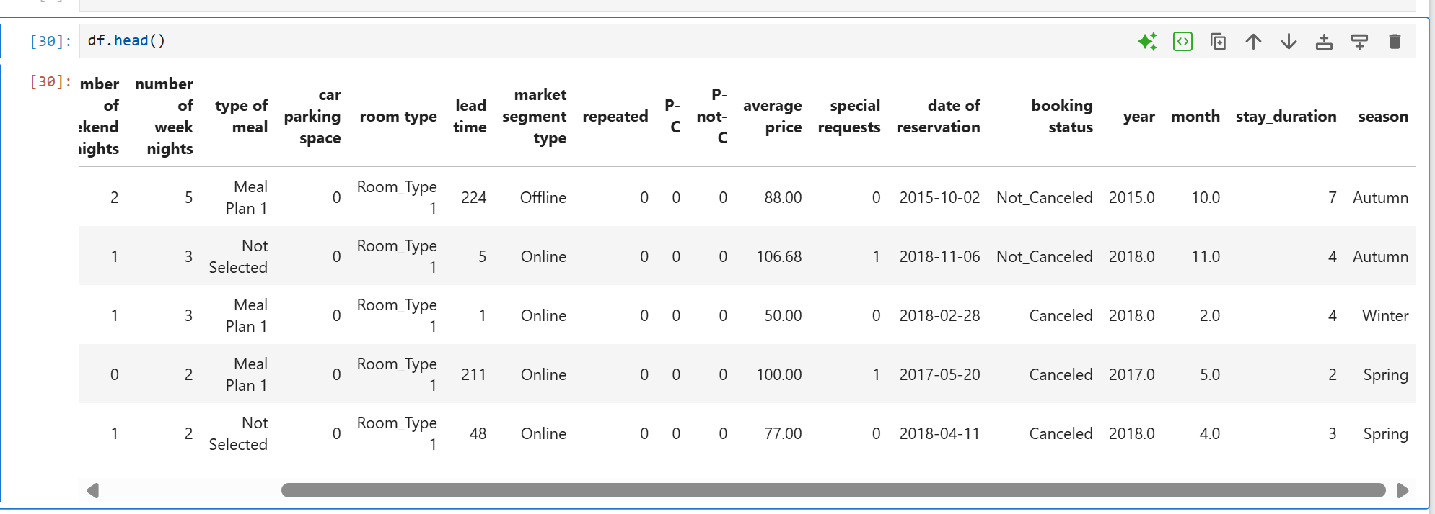
Feature Engineering for Duration and Season
Before
After

Slide 22
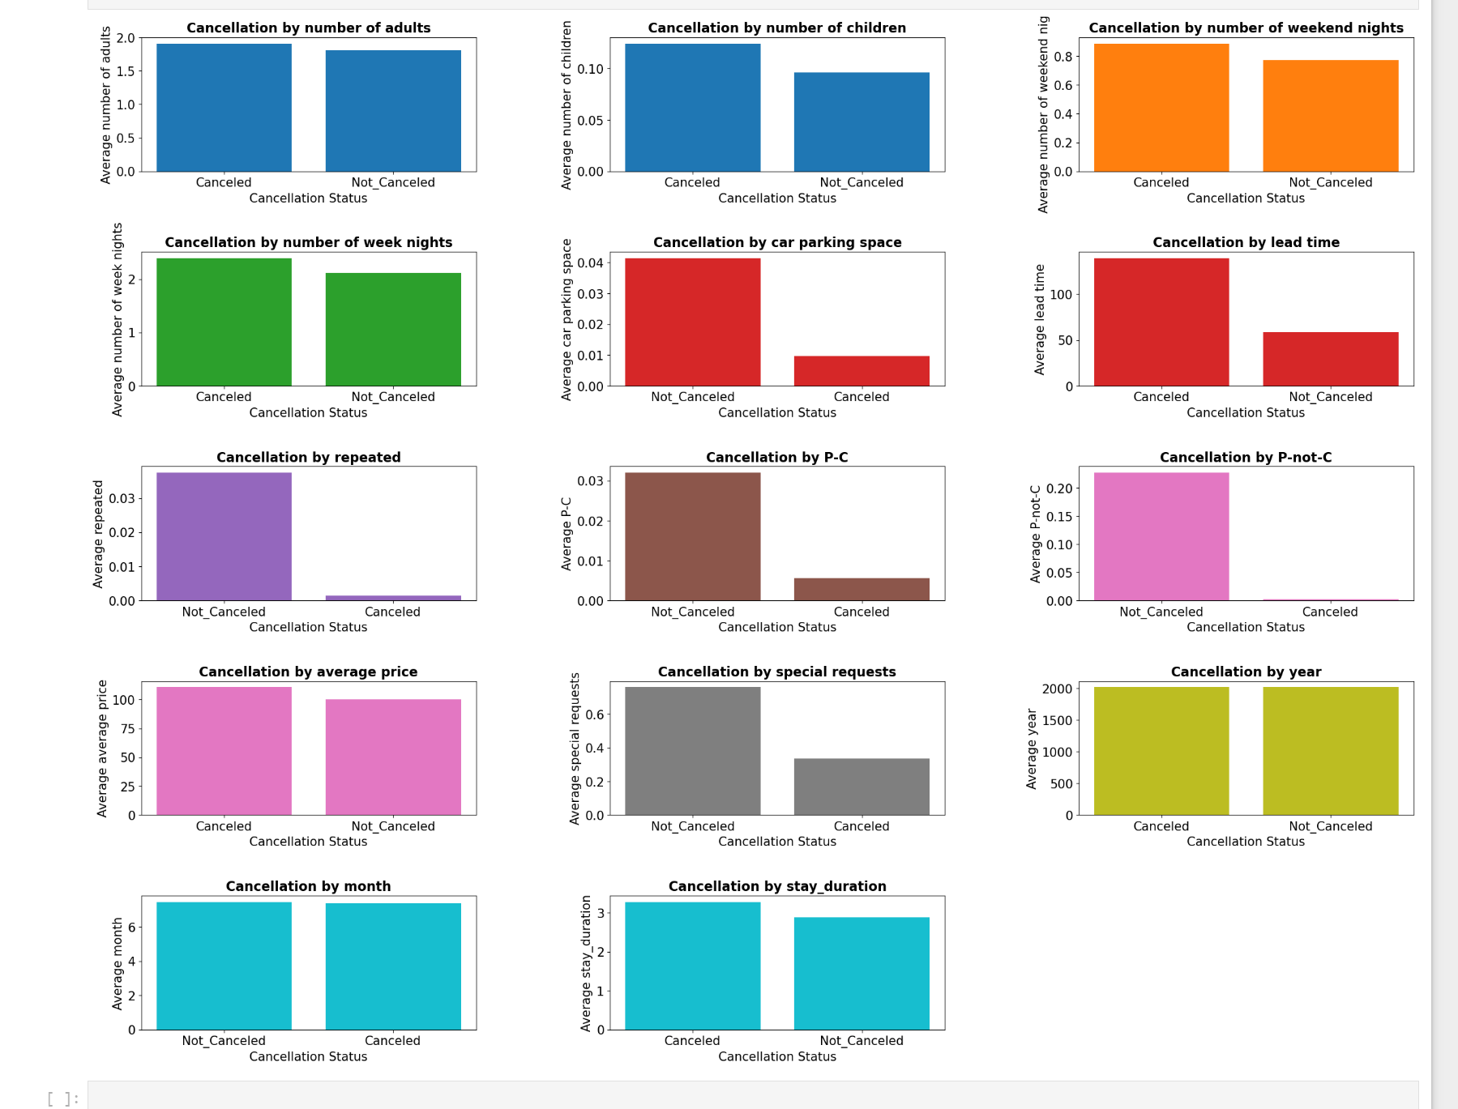
Subplots - Numerical Feature Comparison

Slide 23

Tabular Summary of Cancellation Insights

Slide 24
Table 1 — Feature Impact on Cancellations
Feature | Canceled Bookings | Not-Canceled Bookings | Strength of Impact | Interpretation
Lead Time | High | Low | ⭐⭐⭐⭐⭐ (Very Strong) | Long lead-time bookings are far more likely to cancel.
P-not-C (Non-Customer) | High | Low | ⭐⭐⭐⭐⭐ (Very Strong) | Unknown/new customers cancel much more.
P-C (Customer) | Low | High | ⭐⭐⭐⭐⭐ (Very Strong) | Known/returning customers rarely cancel.
Repeat Guest | Low | High | ⭐⭐⭐⭐ | Loyal guests tend to keep reservations.
Special Requests | Low | High | ⭐⭐⭐⭐ | More invested guests cancel less.

Slide 25
Table 1 — Feature Impact on Cancellations (ctd)
Feature | Canceled Bookings | Not-Canceled Bookings | Strength of Impact | Interpretation
Car Parking Space | Very Low | High | ⭐⭐⭐⭐ | Parking reservation = strong commitment signal.
Average Price | Similar | Similar | ⭐⭐ | Price does not drive cancellation in this dataset.
Week Nights | Slightly Higher | Slightly Lower | ⭐ | Very small difference; weak predictor.
Weekend Nights | Similar | Similar | ⭐ | Not a meaningful contributor.
Adults | Similar | Similar | ⭐ | No significant effect.
Children | Slightly Higher | Slightly Lower | ⭐ | Minimal impact.
Booking Year | Similar | Similar | ⭐ | No clear trend across years.

Slide 26
Table 2 — Highest-Risk vs. Lowest-Risk Booking Profiles
High Cancellation Risk Profile
Low Cancellation Risk Profile
Risk Factor | Description
P-not-C = 1 | Unknown / first-time customer
High Lead Time | Booked far in advance
No Special Requests | Low engagement
No Parking Reservation | No strong intent to stay
Not a Repeat Guest | No loyalty history
Protective Factor | Description
P-C = 1 | Known / returning customer
Short Lead Time | Closer to arrival date
Multiple Special Requests | Strong planning involvement
Has Parking Reservation | Indicates high commitment
Repeat Guest | Very low cancellation likelihood

Slide 27
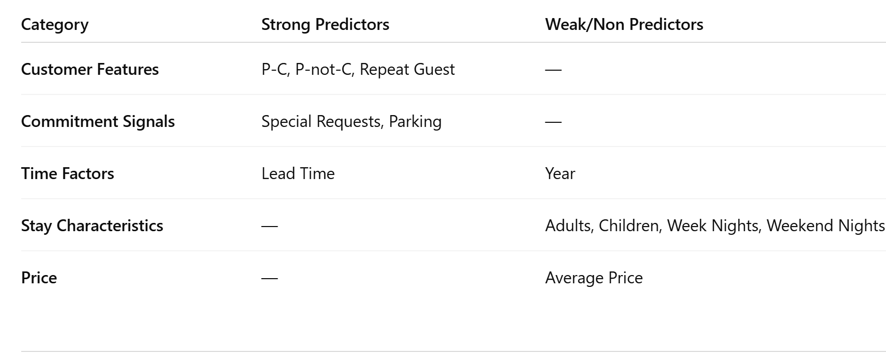
Table 3 — Summary of Key Drivers

Slide 28
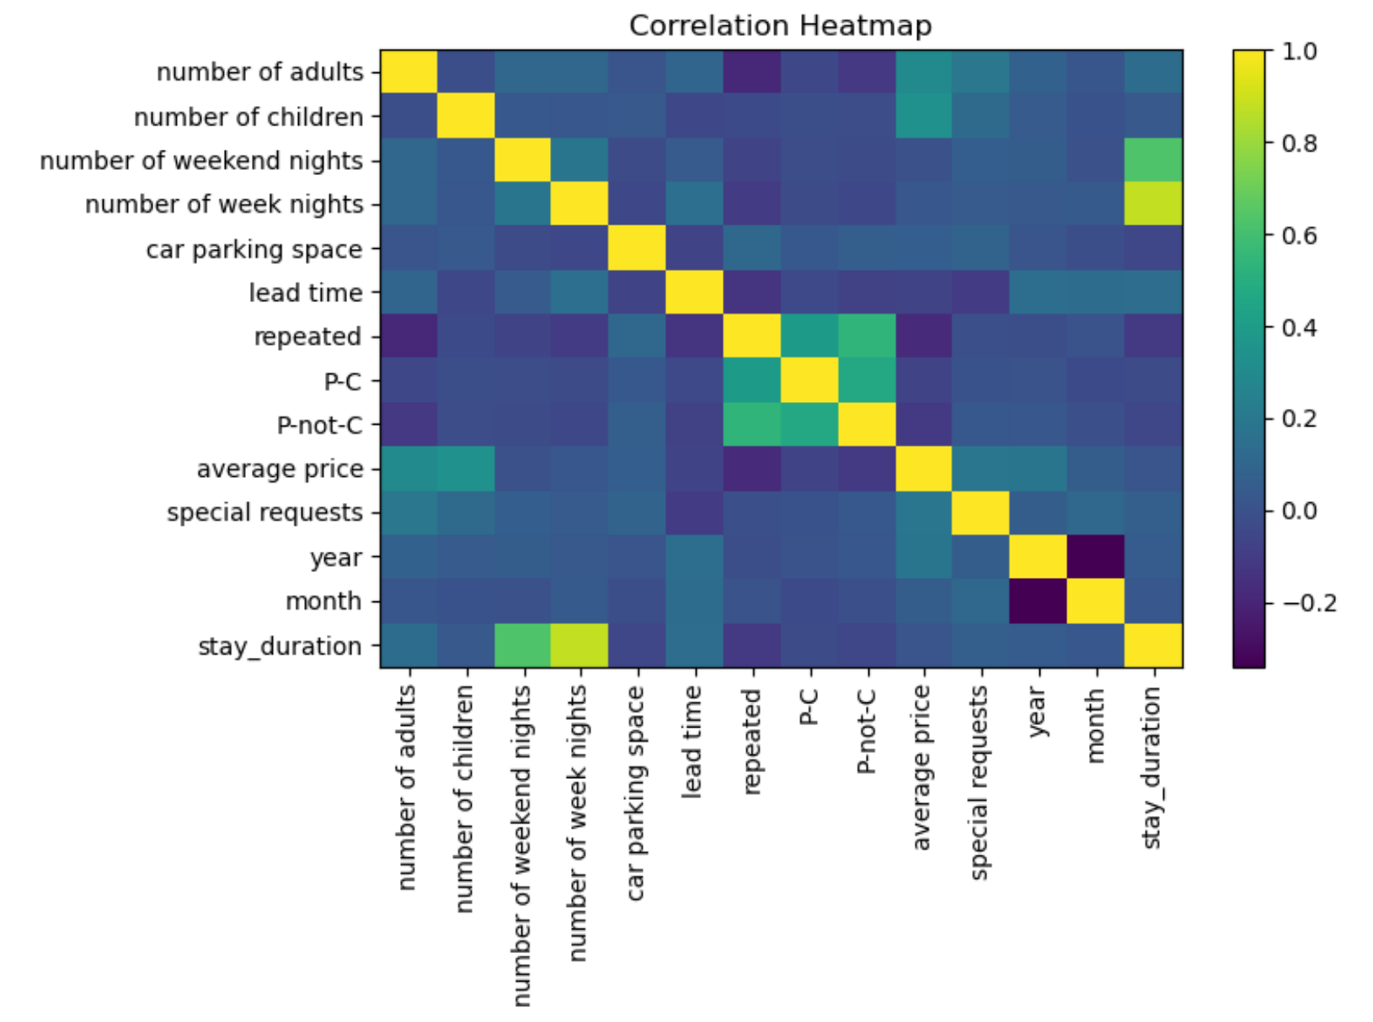
Correlation Analysis
Lead time has the largest positive correlation with cancellation.
Repeated guests tend to cancel less.
Special requests show slight negative correlation → guests with special needs are more committed.

Slide 29
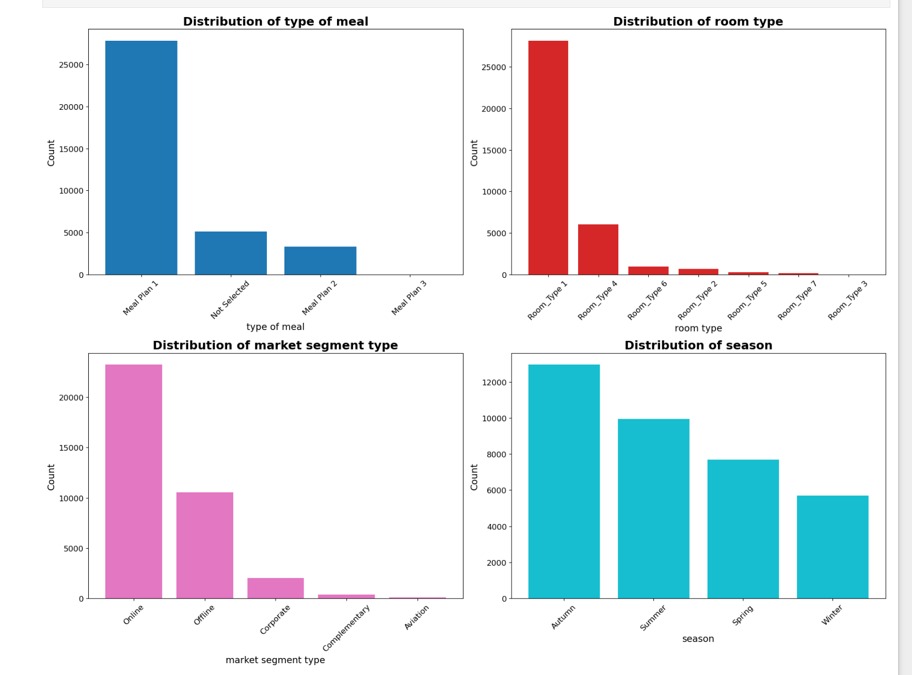
Categorical Features Compared Side-by-Side

Slide 30

Key Insights from Categorical Distribution Plots
Market Segment Influence Certain market segments dominate the booking volume, suggesting that customer acquisition is heavily driven by specific channels. These dominant segments are also likely to have distinct cancellation behaviors, making them important predictors in the model.
Room Type Preferences A small number of room types account for the majority of bookings. This indicates customer preference concentration, which can help hotel management focus pricing and availability strategies on high-demand room categories.

Slide 31
Key Insights ctd.
Meal Plan Selection Most customers choose a limited set of meal plans, with one option
clearly being the most popular. Less frequently selected meal plans may represent niche customer groups or premium offerings.
Seasonal Patterns The seasonal distribution reflects uneven booking demand across the year, with certain seasons attracting more reservations. These seasonal patterns are important for understanding demand fluctuations and cancellation trends.

Slide 32
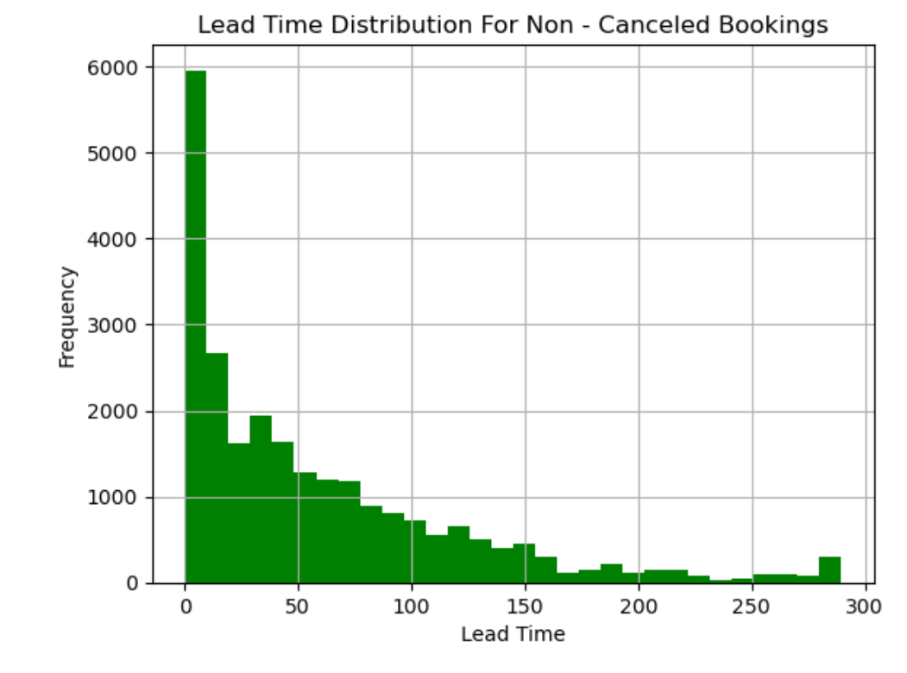
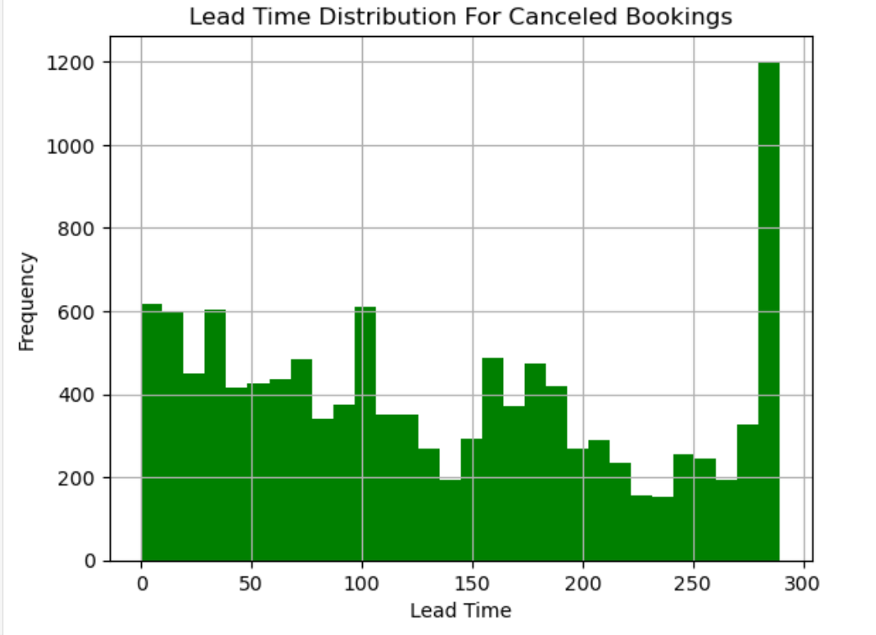
Cancellation rate for each categorical variable
Lead Time Vs Cancelled / Non – Cancelled Booking
Lead Time is a very strong factor for cancellation of bookings. There are more cancellations when Lead Time is high. This means that people who book far in advance have a higher tendency to cancel their booking. There are less cancellations when the Lead Time is short

Slide 33
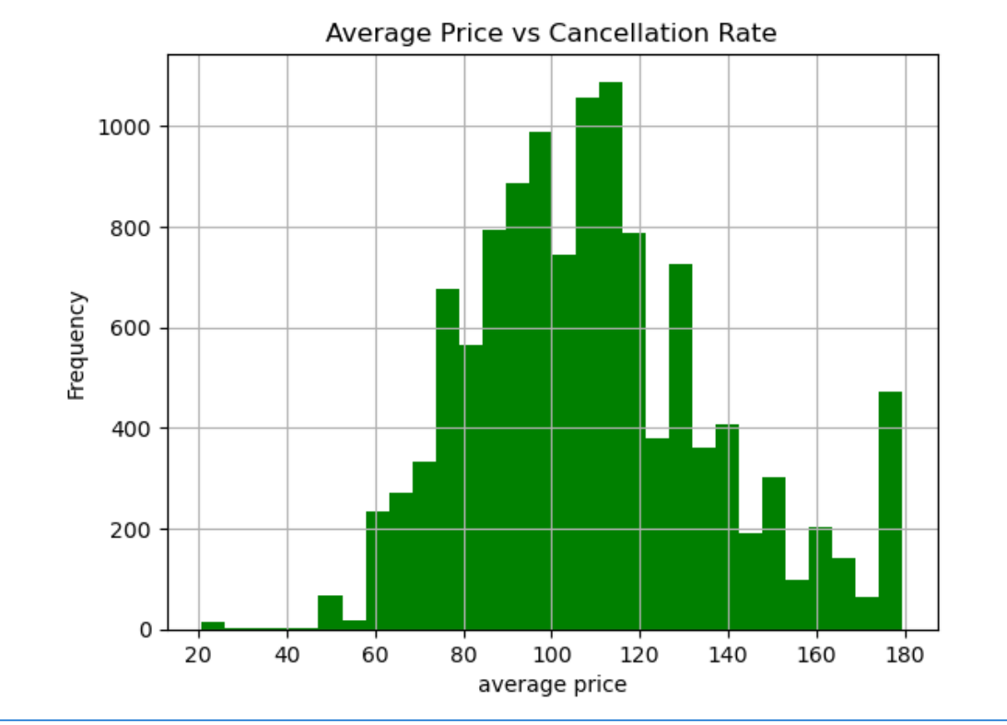
Cancellation rate Vs Average Price
Canceled bookings show slightly higher average price on median. More price variability for canceled bookings → possibly flexible/cautious travellers. Price also contributes to cancellation risk, though not as strongly as lead time.

Slide 34
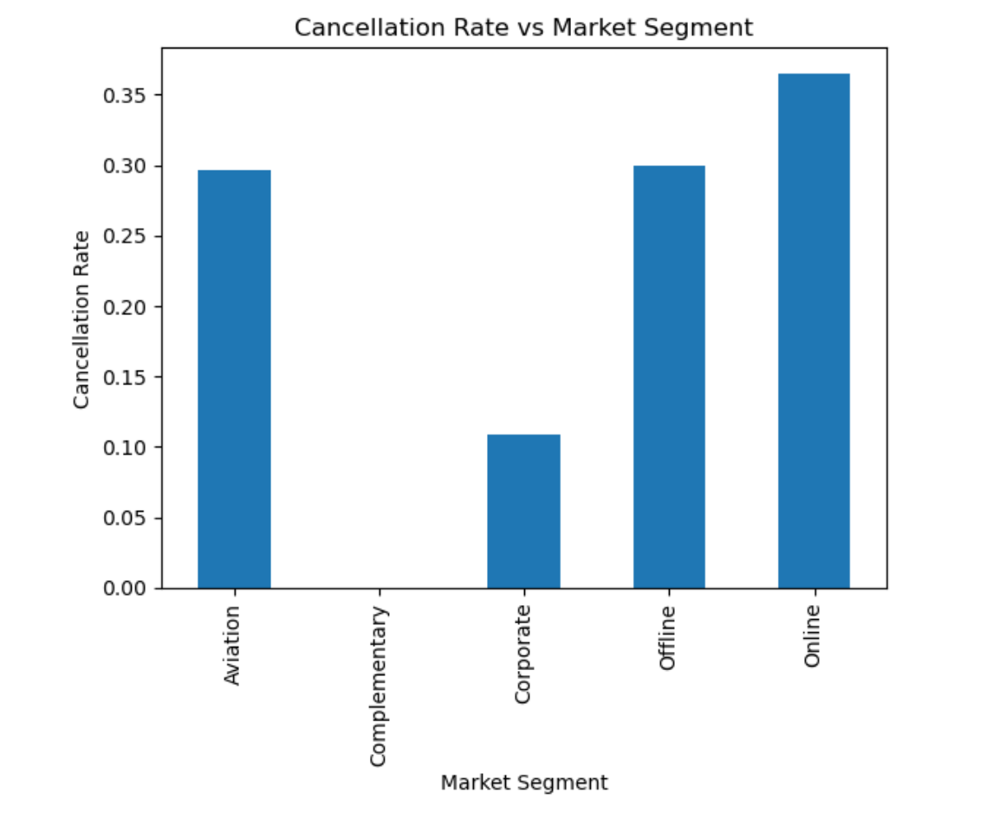
The highest cancellations came from bookings made through intermediaries (online / Travelling agencies). Walk-ins and bookings made directly by guests offline, are less likely to be cancelled.

Slide 35
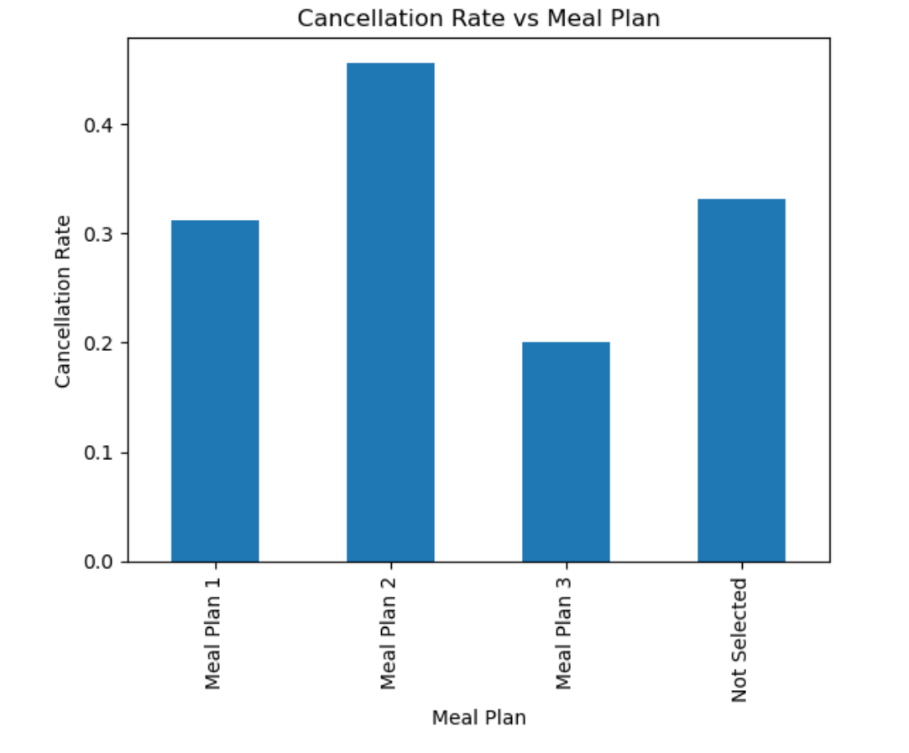
There are little variations across meal types. Meal plan 2 shows a slightly higher cancellation rate. This shows that meal plan is not a strong indicator for cancellations

Slide 36
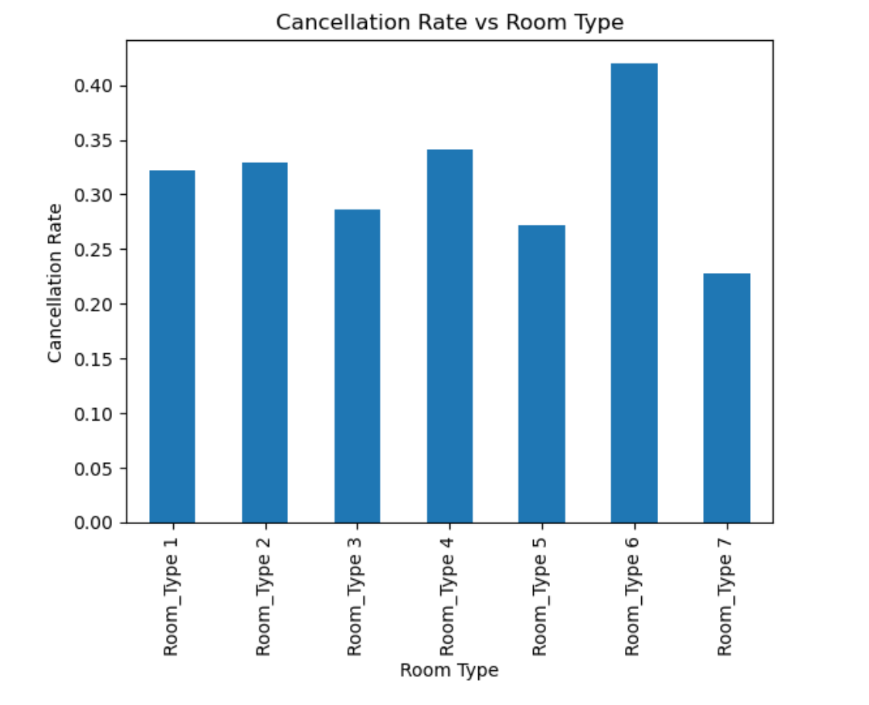

Slide 37
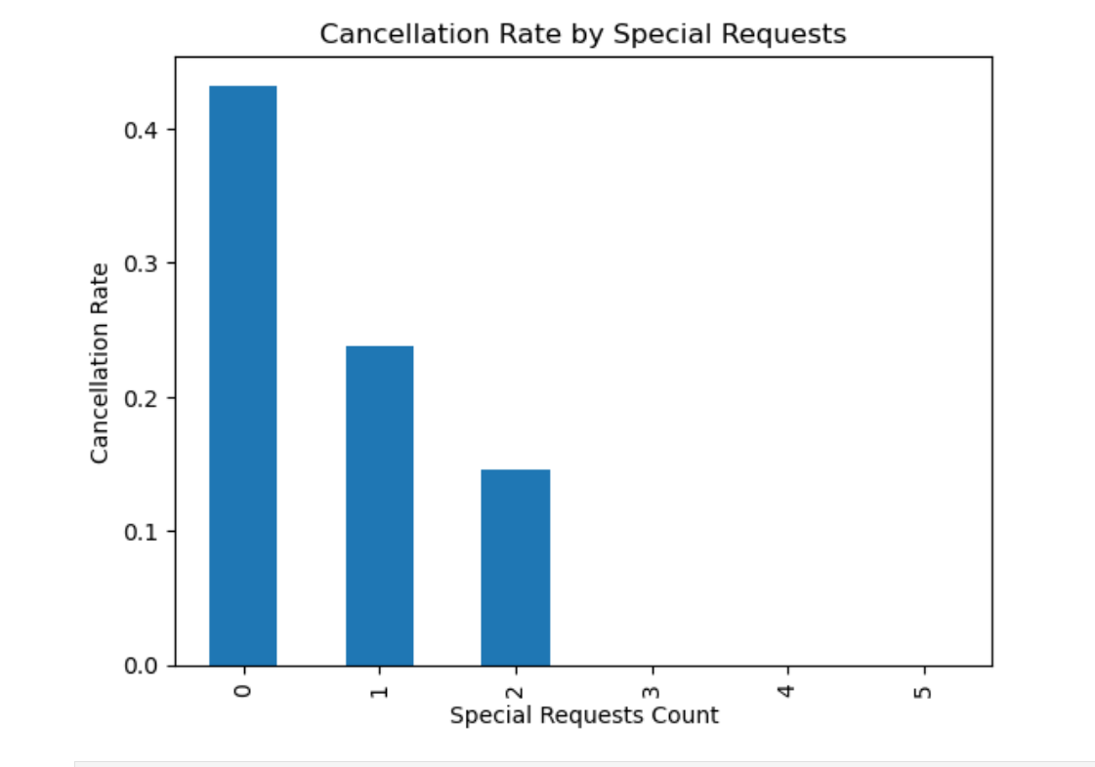

Slide 38
Key Insights from Categorical Cancellation-Rate Analysis
Category | Variable | High-Risk Group(s) (Higher Cancellation Rate) | Low-Risk Group(s) (Lower Cancellation Rate) | Key Insight
Meal Preference | Type of Meal | Not Selected, Meal Plan 3 | Meal Plan 1 | Guests without meal commitment cancel more often
Room Selection | Room Type | Rare / Premium room types (e.g., Types 3, 5, 6, 7) | Room Type 1 (Standard) | Premium & limited rooms face higher uncertainty
Booking Channel | Market Segment Type | Online | Corporate, Aviation, Complementary | Online bookings are speculative and price-sensitive
Seasonality | Season | Autumn, Winter | Summer | Transitional & weather-sensitive seasons raise cancellations
Commitment Level | Combined Behavior | No meal + online + premium room | Meal plan + offline/corporate | Low commitment strongly predicts cancellation

Slide 39
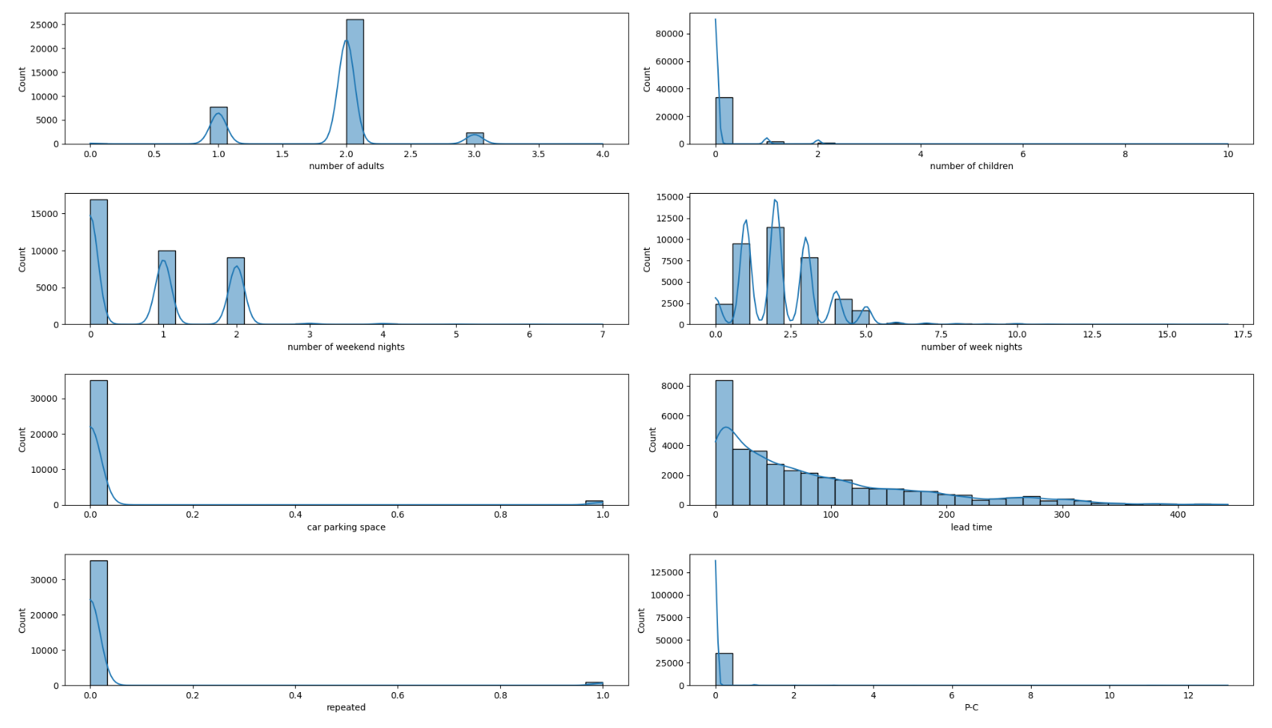
Using Histplots to check outliers

Slide 40
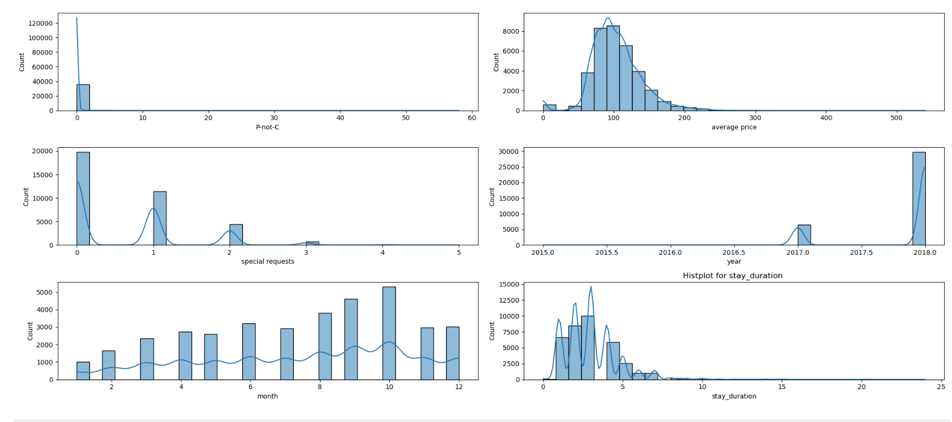
Histplots (ctd)

Slide 41
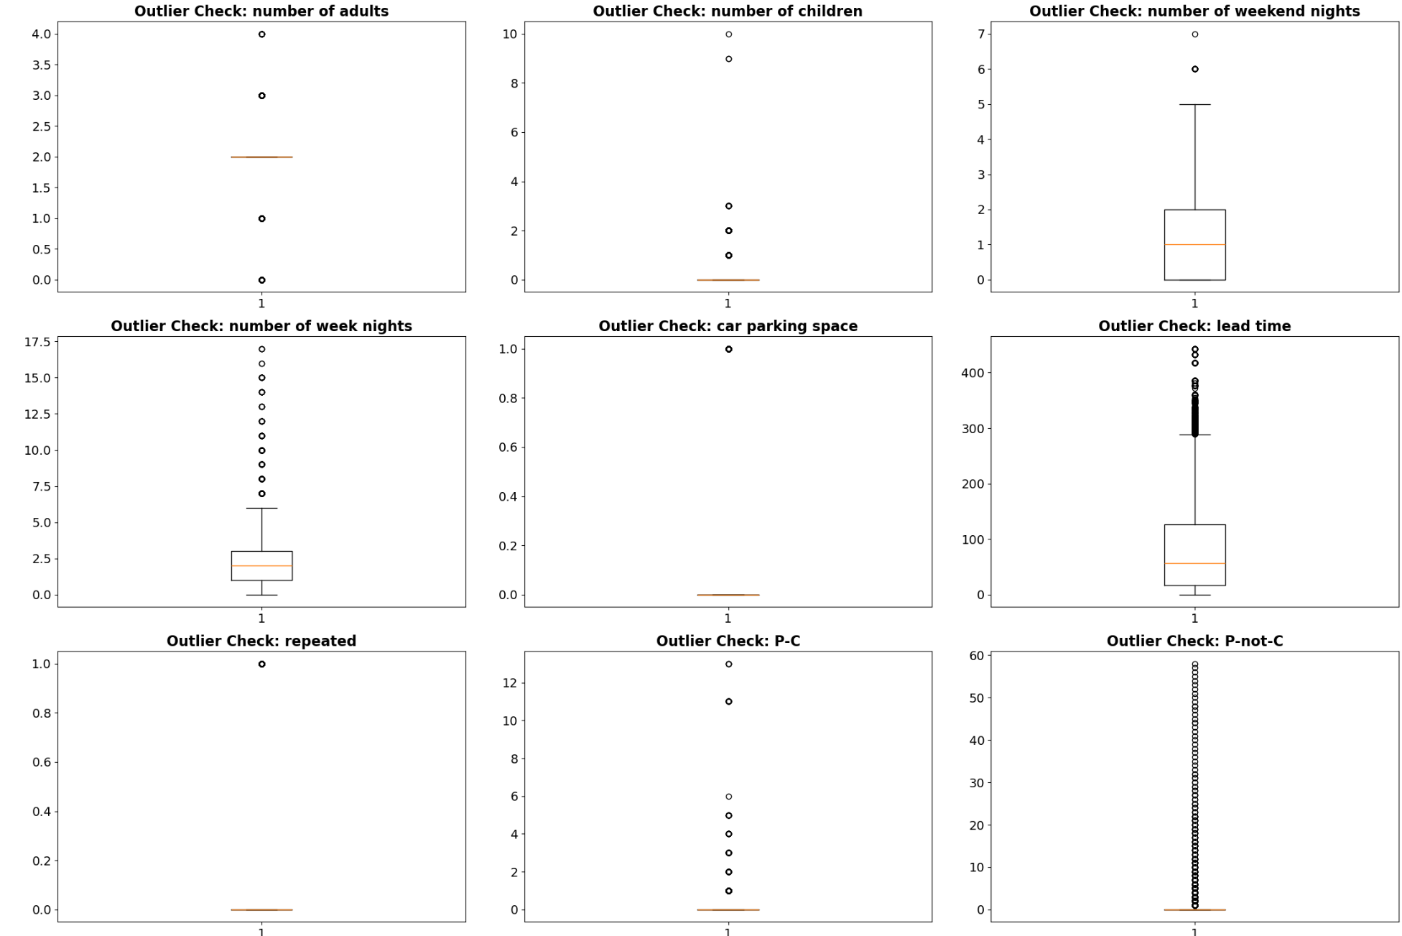
Using boxplots to check outliers

Slide 42
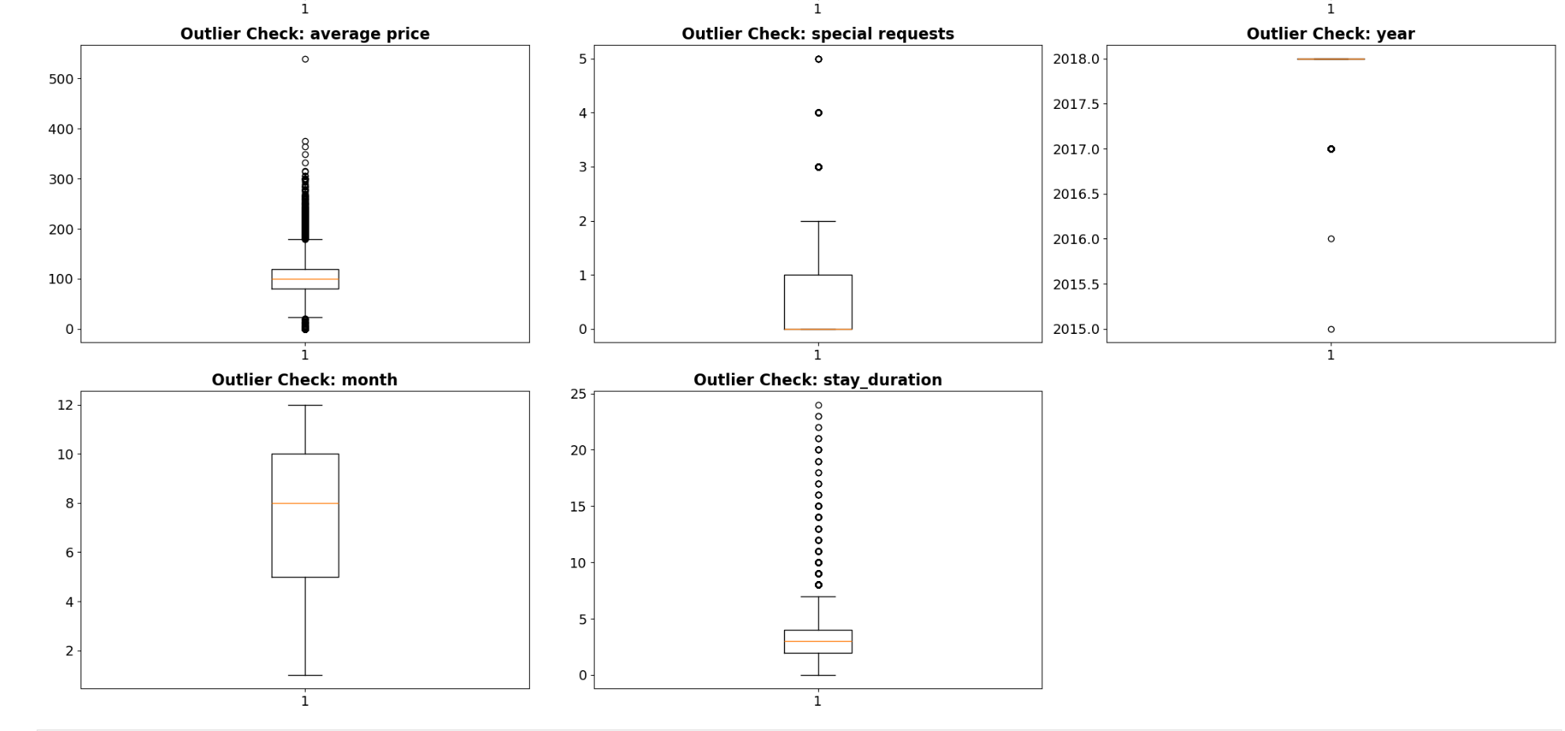
Boxplots (ctd)

Slide 43
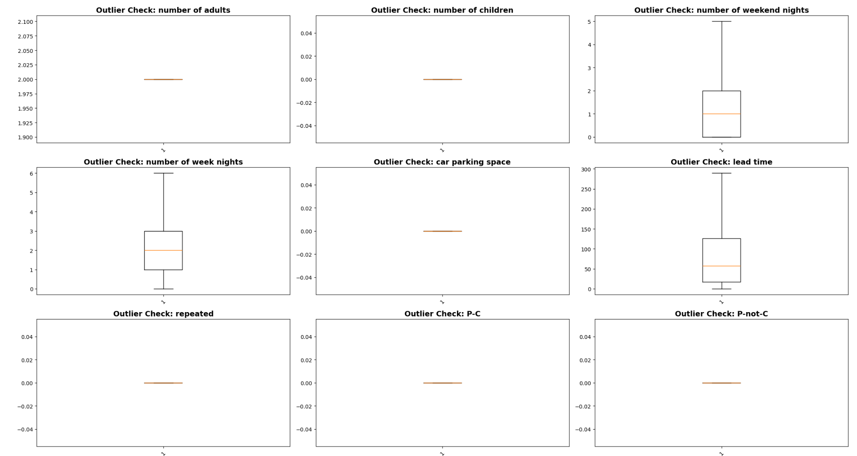
Using boxplots to fix the outliers

Slide 44
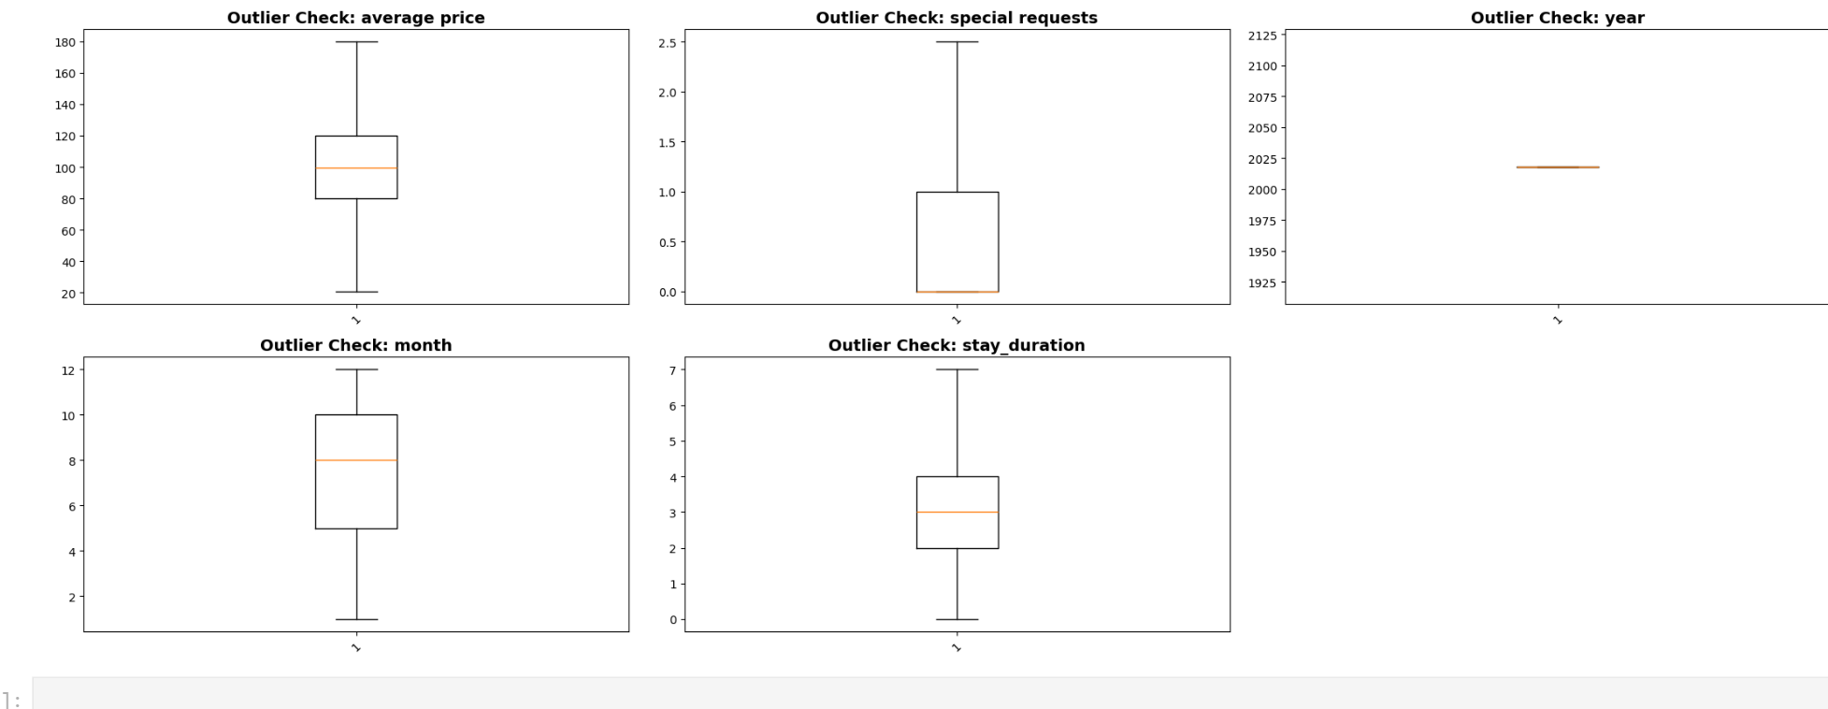
Boxplots (ctd)

Slide 45
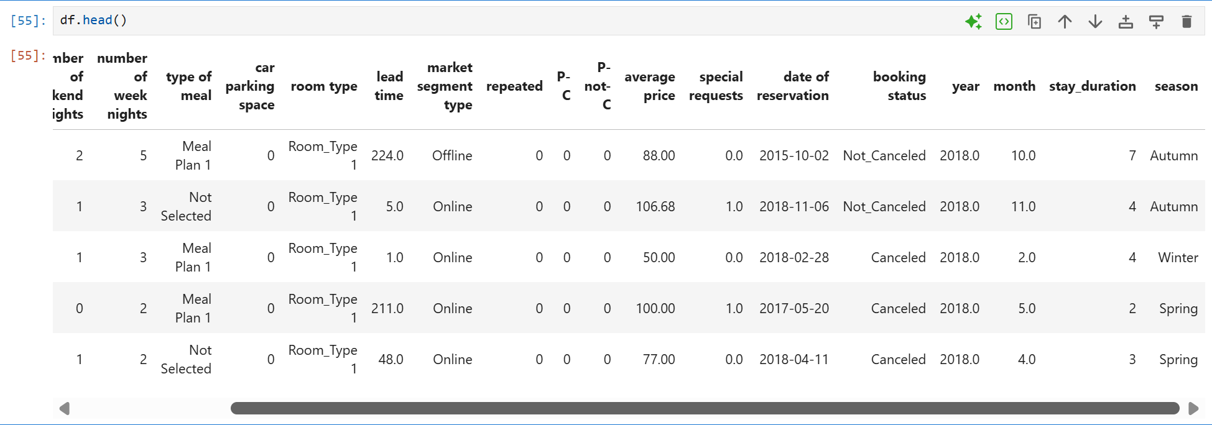
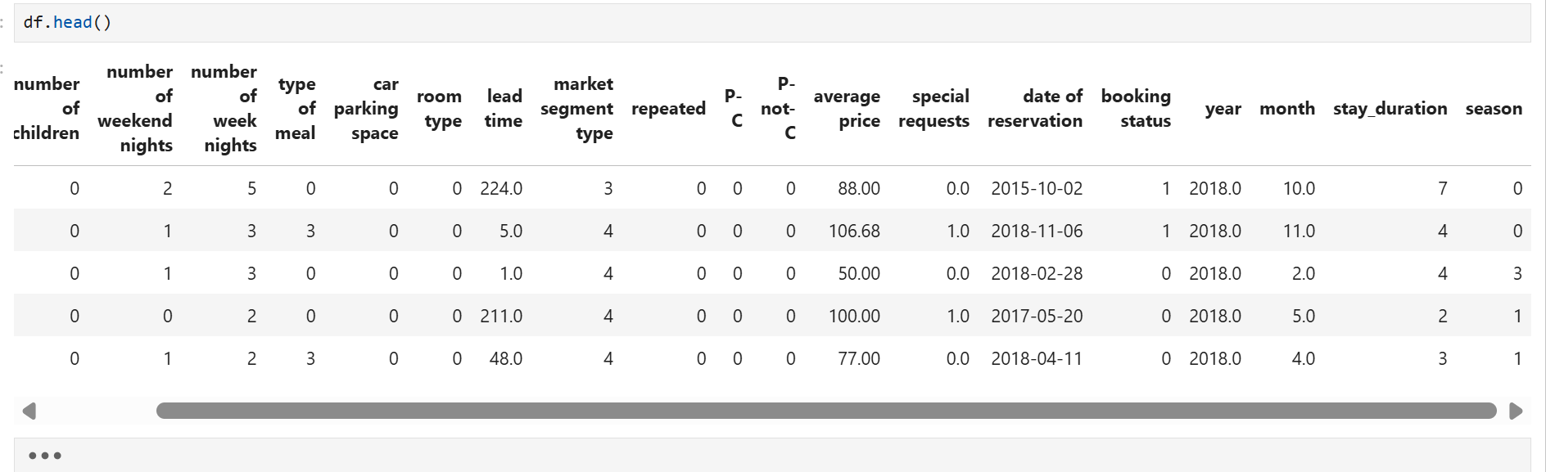
Encoding Categorical Variables
Before
After

Slide 46
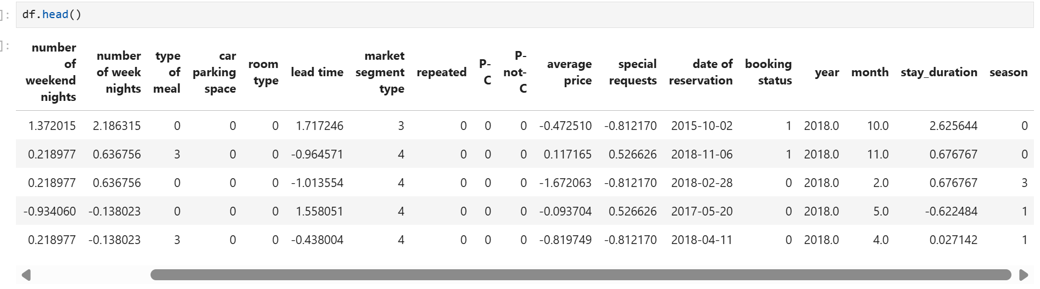
Scaling Numerical Features

Slide 47
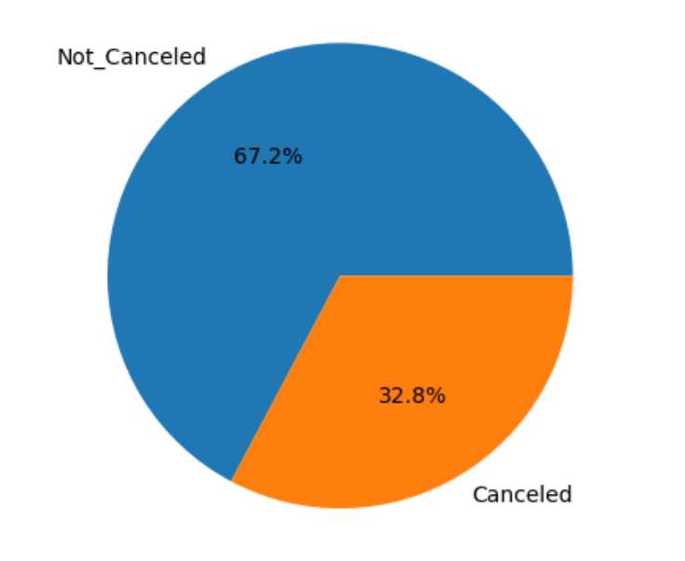
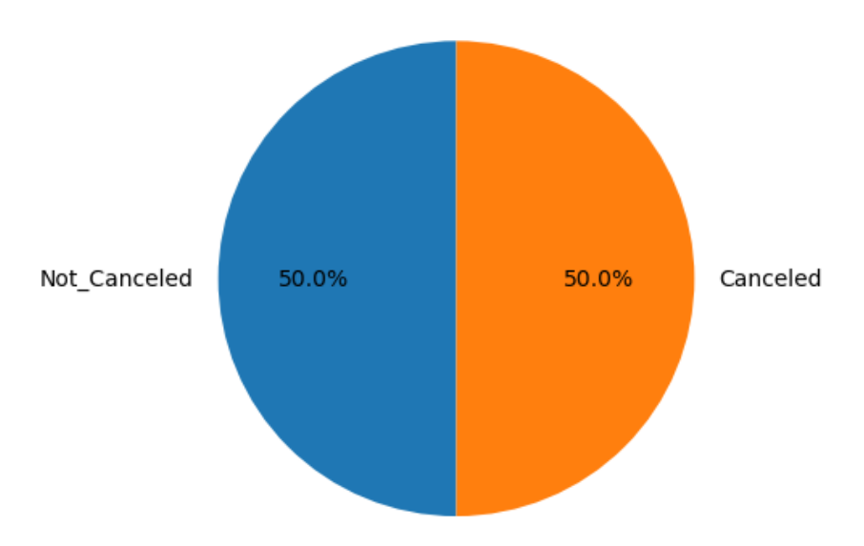
Handle Class Imbalance
Booking Status Distribution
Before SMOTE
After SMOTE

Slide 48
Machine Learning
Base line Model Building
Training Advanced Models
Hyper Parameter Tuning
Final Model Evaluation

Slide 49
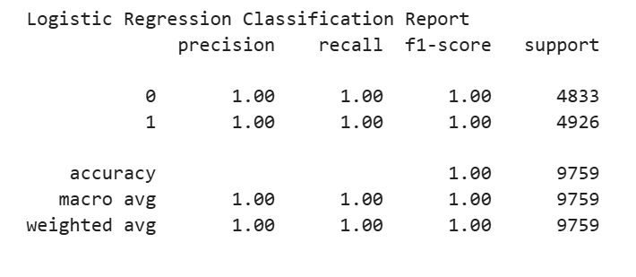
Baseline Model – Logistic Regression
Model showed an accuracy of 100%

Slide 50
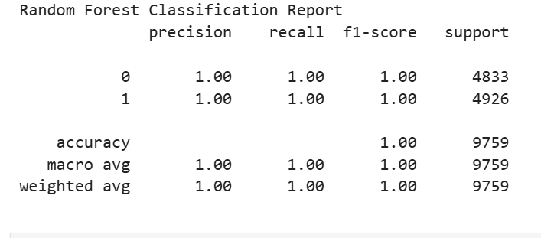
Advanced Model – Random Forest
Model also showed an accuracy of 100%

Slide 51
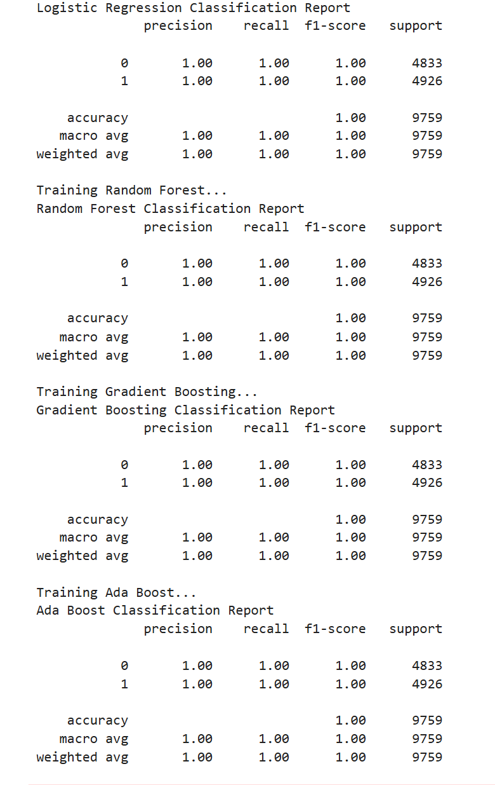
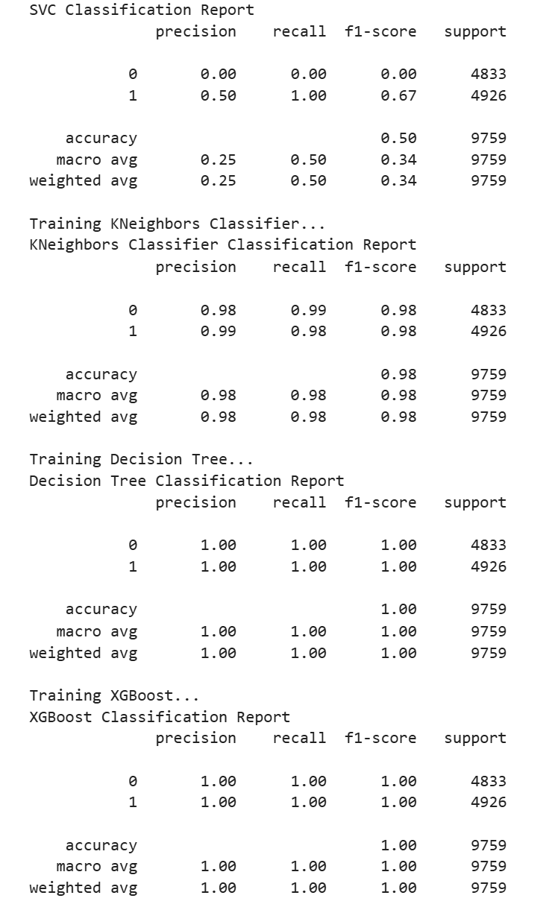
Training Multiple Classification Models

Slide 52
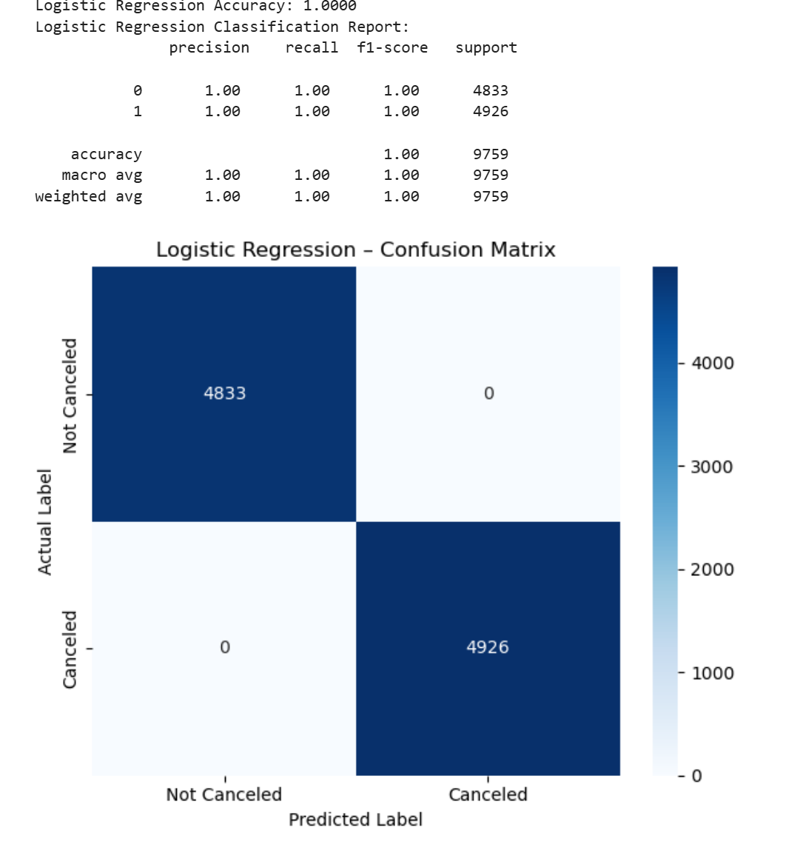
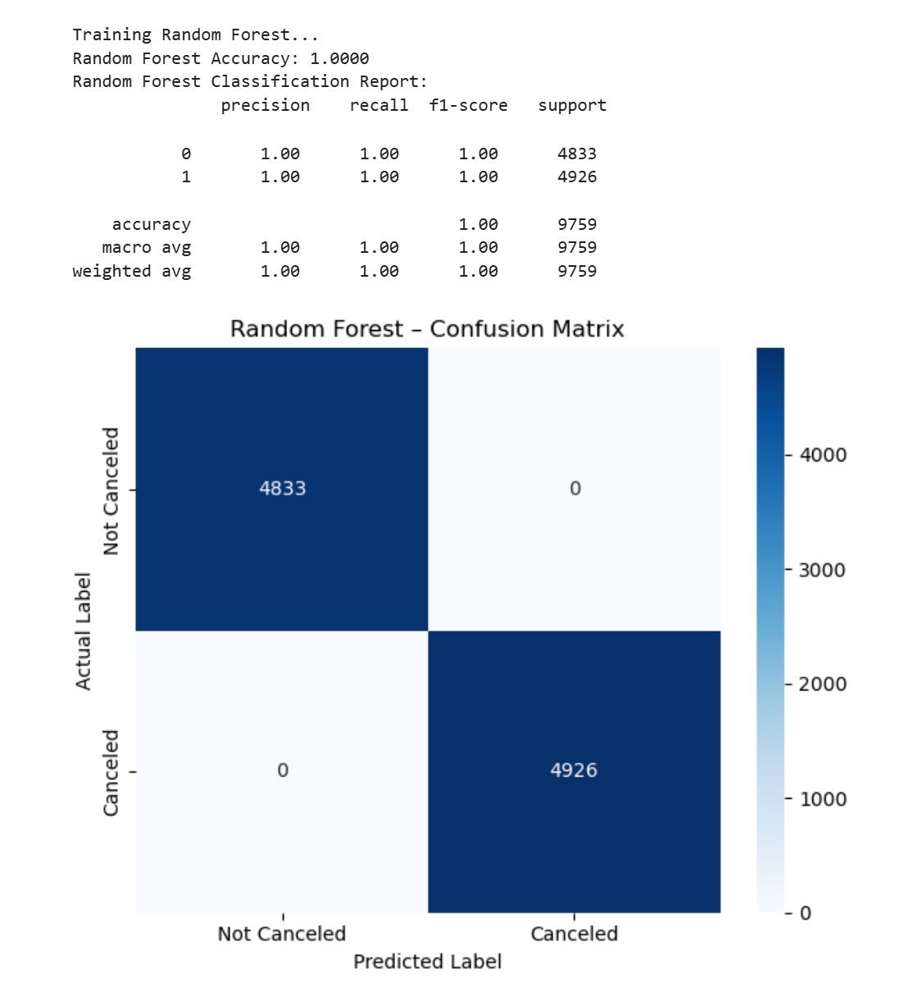
Confusion Matrix
Logistic Regression
Random Forest

Slide 53
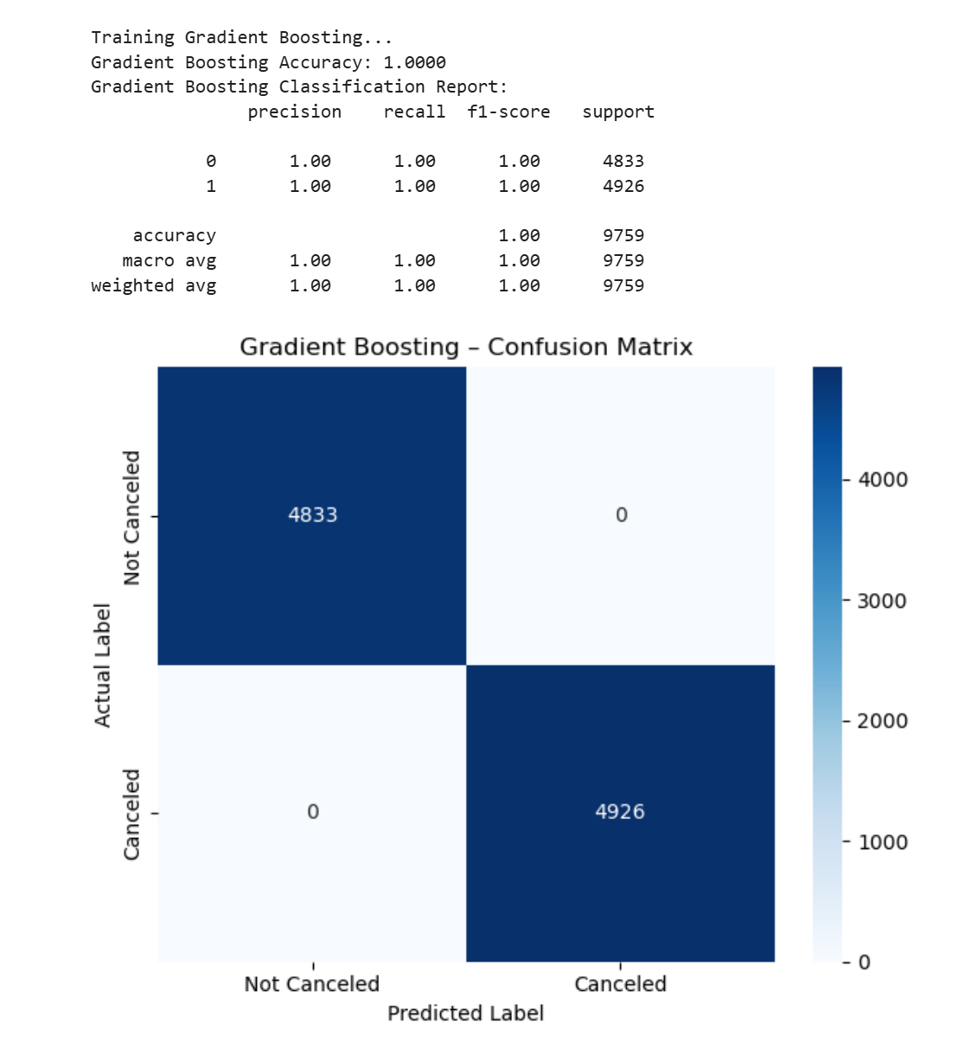
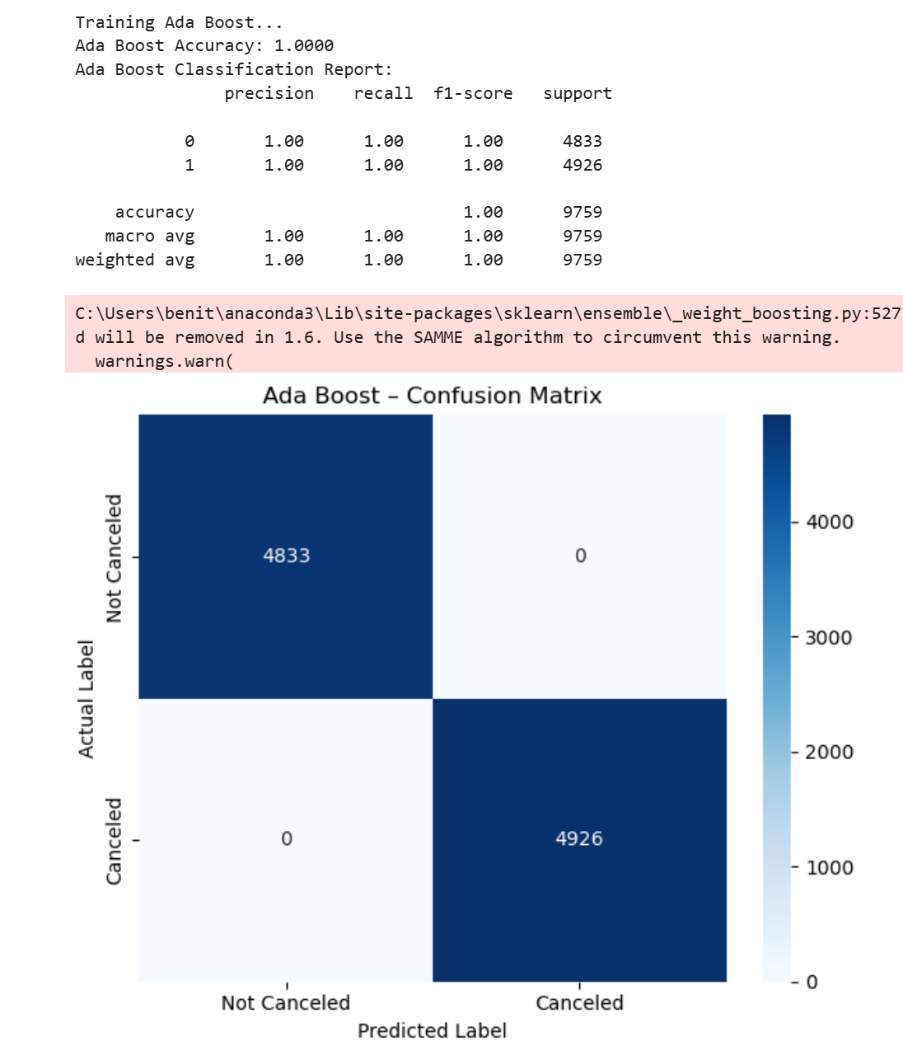
Confusion Matrix
Gradient Boosting
Ada Boost

Slide 54
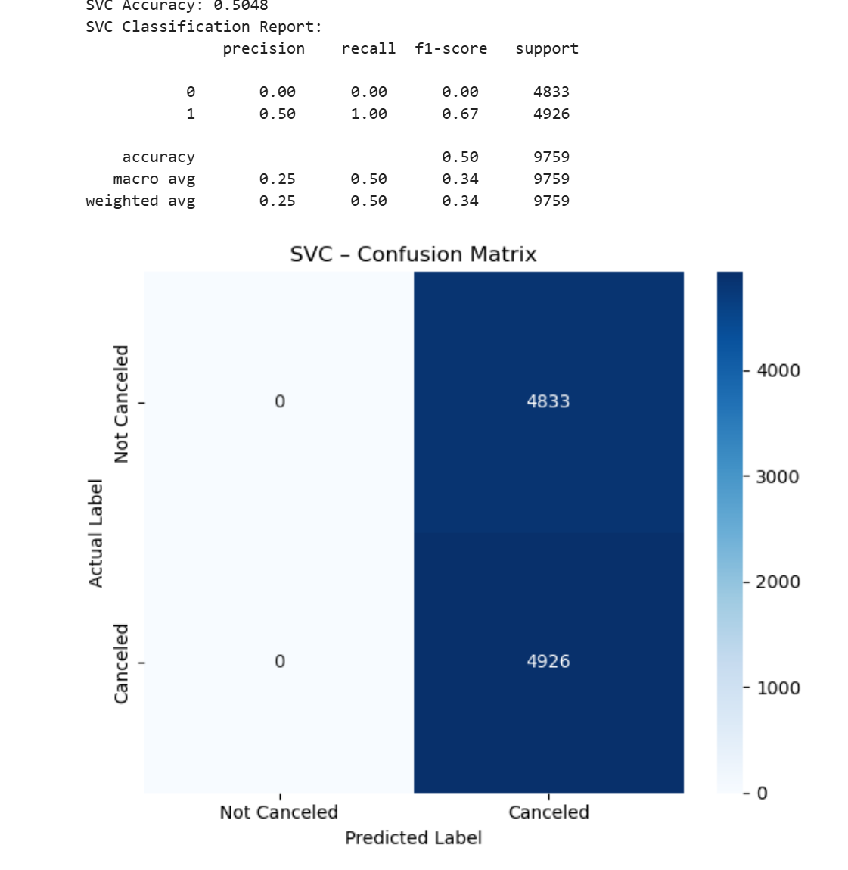
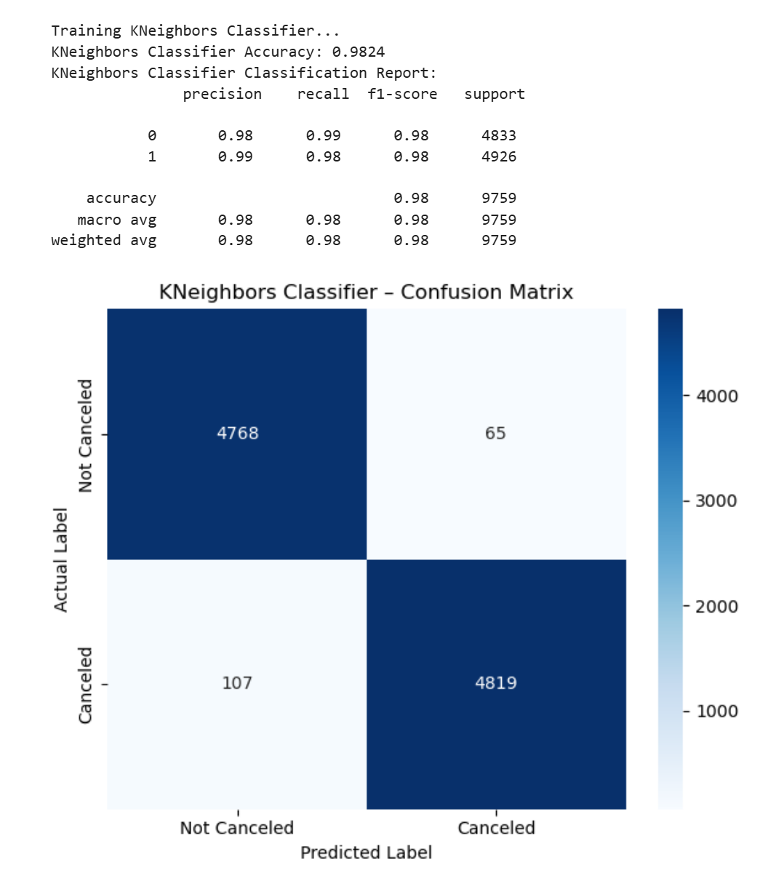
Confusion Matrix
SVC
KNeighbors

Slide 55
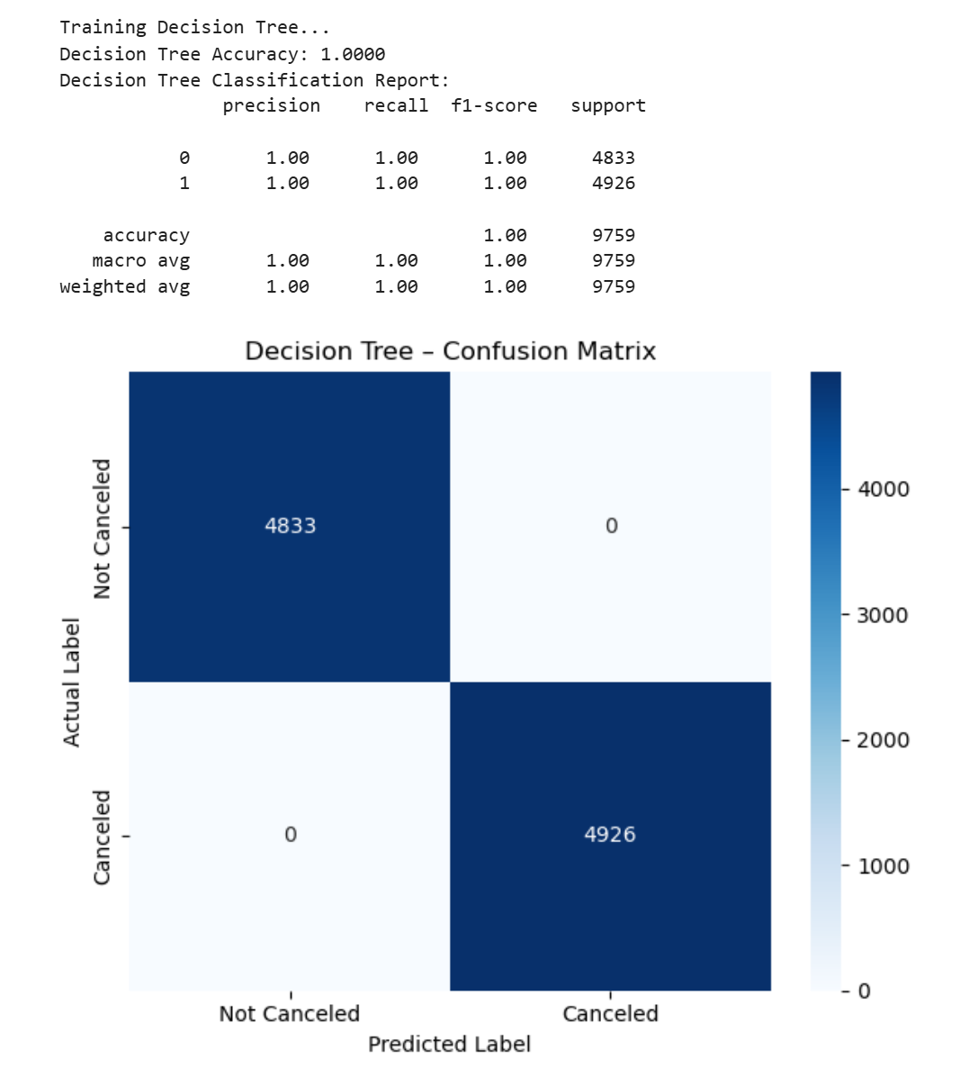

Confusion Matrix
Decision Tree
XGBoost

Slide 56
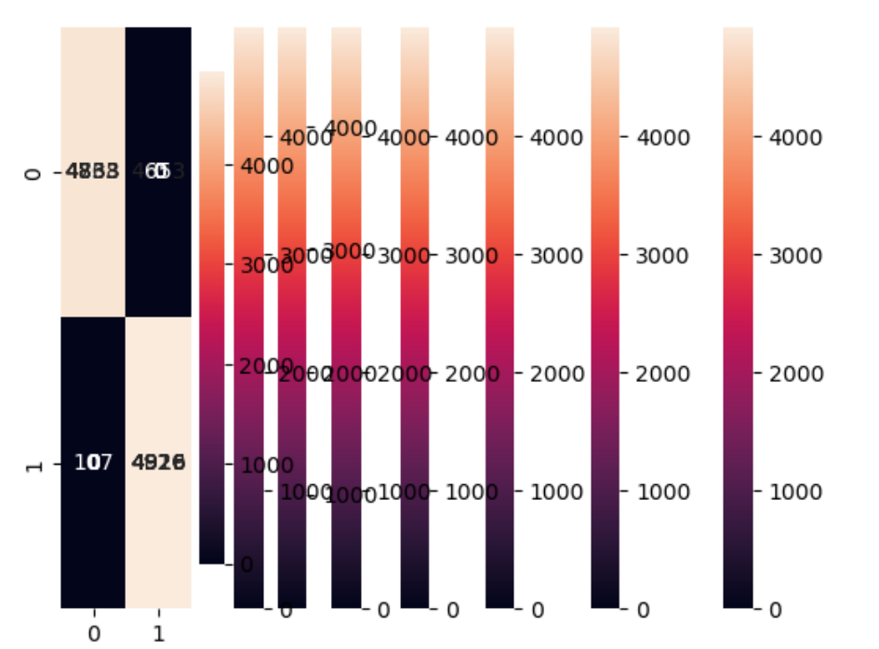
Heatmap

Slide 57
Feature Importance Analysis
Feature | Type | Behavioral Meaning | Observed Impact on Cancellations | Justification for Model Importance
Market Segment Type | Categorical | Booking channel & intent | Online bookings show highest cancellation rates | Reflects price sensitivity and speculative booking behavior
Type of Meal | Categorical | Level of guest commitment | No meal plan associated with higher cancellations | Indicates low upfront commitment
Room Type | Categorical | Price & availability preference | Premium / rare room types cancel more often | High cost and flexibility increase cancellation likelihood
Lead Time | Numerical | Planning horizon | Longer lead times increase cancellations | More time allows plan changes
Average Price | Numerical | Cost sensitivity | Higher prices correlate with cancellations | Guests are more likely to abandon expensive bookings
Stay Duration | Numerical | Trip significance | Short stays cancel more frequently | Lower sunk cost reduces commitment
Season | Categorical | Demand volatility | Autumn & Winter show higher cancellation rates | Weather and schedule uncertainty affect travel decisions
Repeated Guest | Binary | Customer loyalty | Repeat guests cancel less often | Loyalty implies trust and intent
Special Requests | Numerical | Booking engagement | More requests correlate with fewer cancellations | Higher engagement signals commitment

Slide 58
Overall Strategic Insight
Cancellation risk is driven by commitment, not volume. Guests who commit financially or structurally (meal plans, corporate travel, standard rooms) are far less likely to cancel.

Slide 59
Conclusion
This project focused on analyzing hotel booking data to understand the drivers of reservation cancellations, develop predictive models capable of identifying high-risk bookings and help reduce revenue loss while improving operational efficiency. Exploratory data analysis revealed that booking cancellations are strongly influenced by factors such as lead time, average price, length of stay, market segment, and seasonality. Customers with longer lead times, higher room prices, and bookings made through certain market segments showed a higher tendency to cancel. In particular, bookings made through online channels, reservations without meal plan selection, premium or less common room types, and bookings during transitional seasons such as Autumn and Winter exhibited substantially higher cancellation rates.
Two machine learning models—Logistic Regression and Random Forest—were trained and evaluated using a balanced dataset. While Logistic Regression provided a useful baseline with interpretable results, the Random Forest model consistently outperformed it across all evaluation metrics. In particular, Random Forest achieved higher recall and F1-scores for canceled bookings, indicating a stronger ability to correctly identify reservations that are at high risk of cancellation.
The confusion matrix analysis further confirmed that the Random Forest model is better suited for capturing complex, non-linear relationships in booking behavior.
The results demonstrate that cancellation risk is driven more by behavioral commitment than by booking volume. Guests who show higher commitment—such as selecting meal plans, booking standard room types, or traveling through corporate channels—are significantly less likely to cancel
Overall, the results demonstrate that predictive modeling can be effectively leveraged to anticipate cancellations and support proactive, data-driven decision-making in hotel operations.

Slide 60
Recommendations
Based on the findings of this analysis, the following recommendations are proposed:
Early Identification of High-Risk Bookings The hotel should deploy the Random Forest model to flag bookings with a high probability of cancellation, particularly those with long lead times, high prices, or low customer commitment indicators.
Targeted Retention Strategies For bookings identified as high risk, the hotel can implement proactive measures such as reminder emails, flexible rebooking options, loyalty incentives, or limited-time discounts to encourage guests to keep their reservations.
Dynamic Cancellation Policies Cancellation policies can be adjusted based on risk level. For example, stricter cancellation terms may be applied to bookings with historically high cancellation likelihood, while more flexible policies can be offered to loyal or low-risk customers.
Operational Planning and Resource Allocation Accurate cancellation predictions allow hotel management to better plan staffing, inventory, and pricing strategies, reducing wasted resources and improving guest experience.
Continuous Model Monitoring and Improvement The model should be retrained periodically using new booking data to ensure performance remains robust and reflects changing customer behavior and market conditions.

Slide 61

Final Remark
By integrating machine learning-based cancellation prediction into its operations, the hotel can move from reactive decision-making to a proactive, data-driven strategy. This approach not only minimizes revenue loss from cancellations but also enhances customer satisfaction and overall operational efficiency.

Slide 62

Thank you

